Slide 1
Introduction to Git and GitHub
Dr. Eric Garcia
Old Dominion University

Slide 2
Flow of the Code
Create your code
Bash
Python
R
Manage your code
Git : Control version
Share your code
GitHub
Get code online
GitHub
Other Sources

Slide 3
Remote Repository
Websites
Remote Servers
files – directories
Code
Data
Publication
Book Materials
Classes
Workshops
Get code online
GitHub
Other Sources

Slide 4
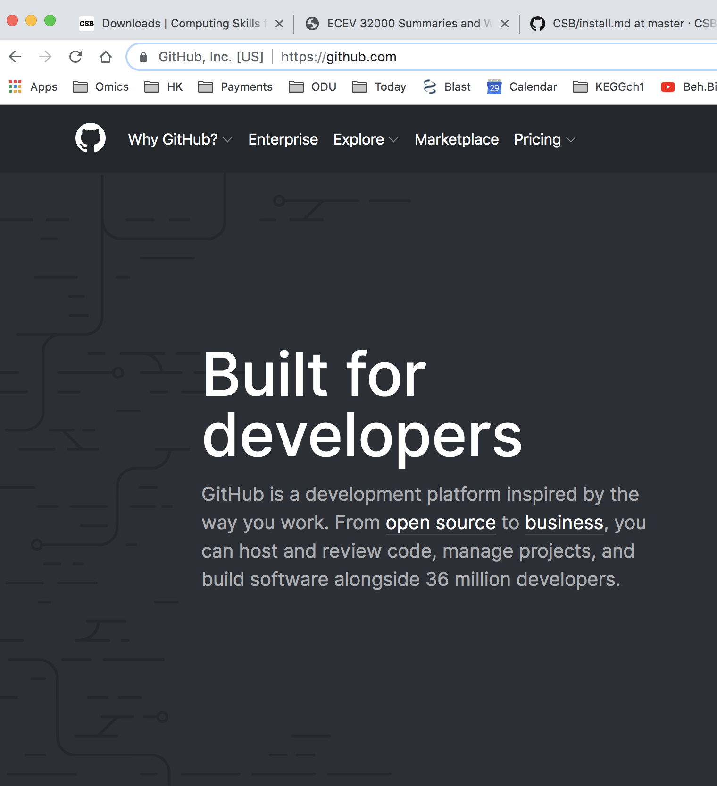
Remote Repository
https://github.com
Git: Version Control
Get code online
GitHub
Other Sources

Slide 5
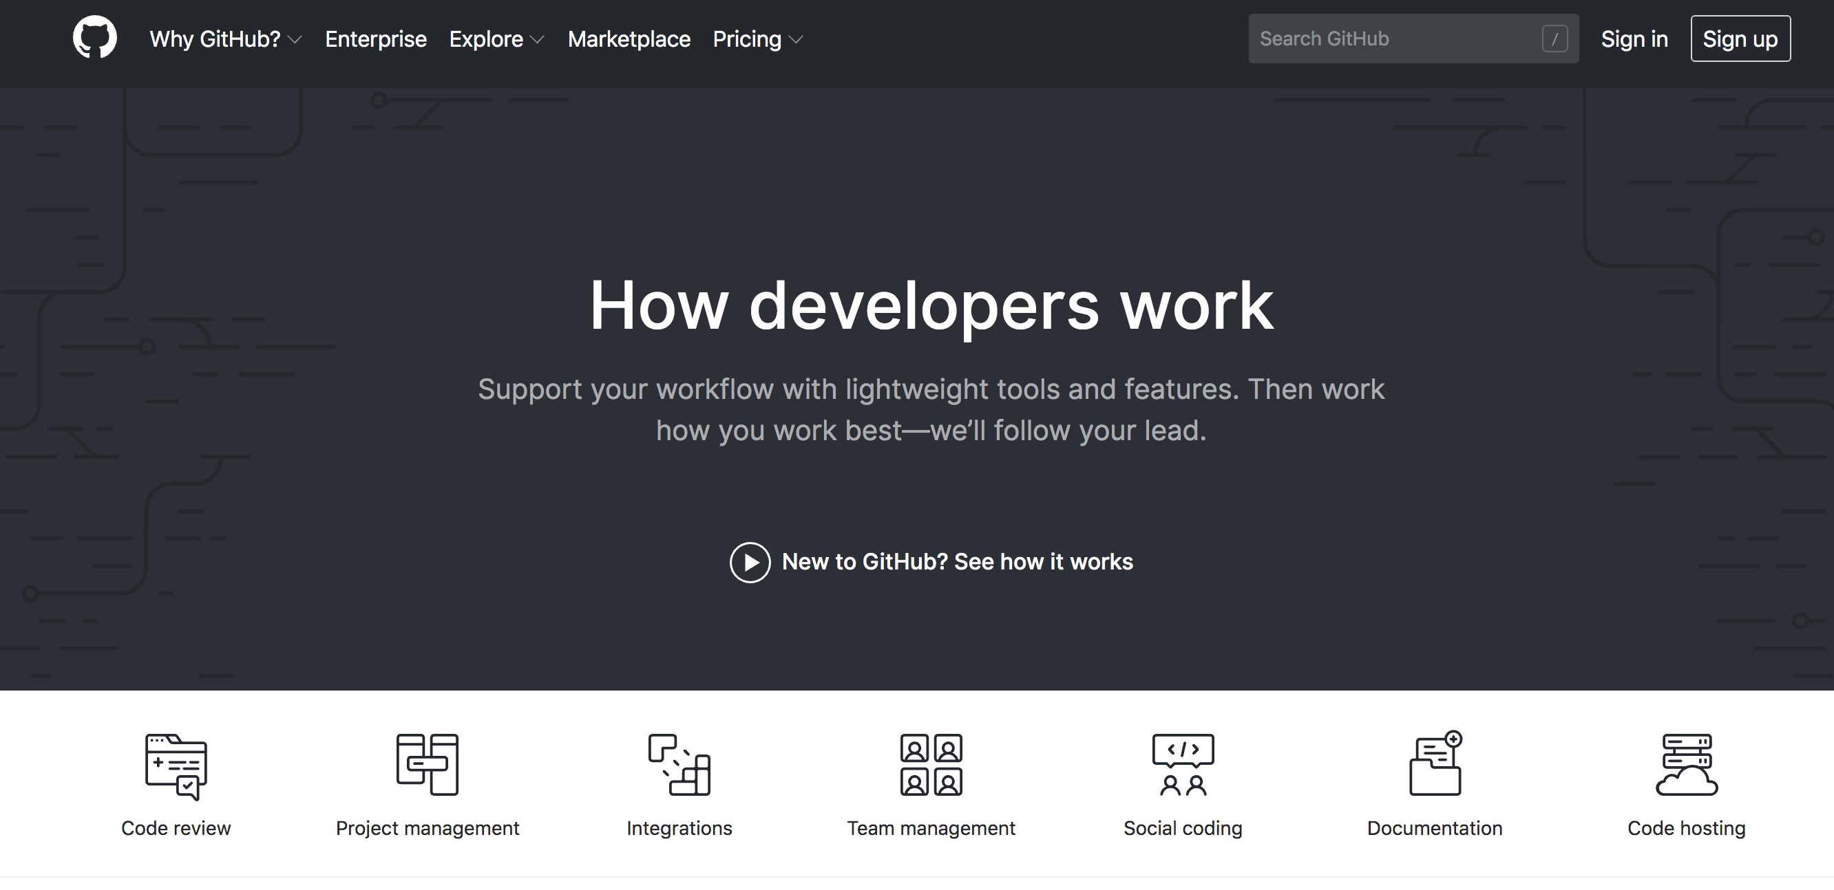

Slide 6
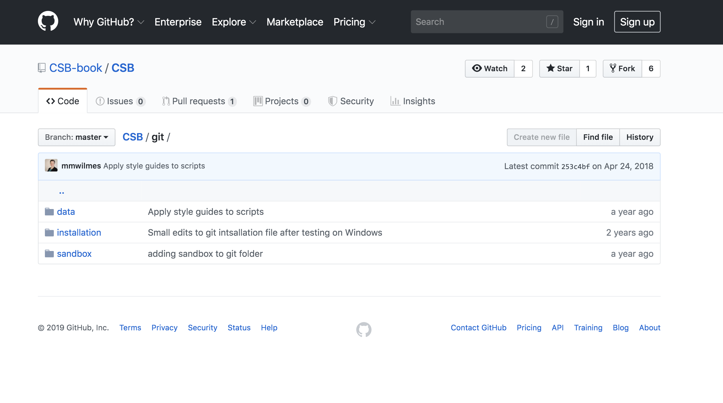

Slide 7
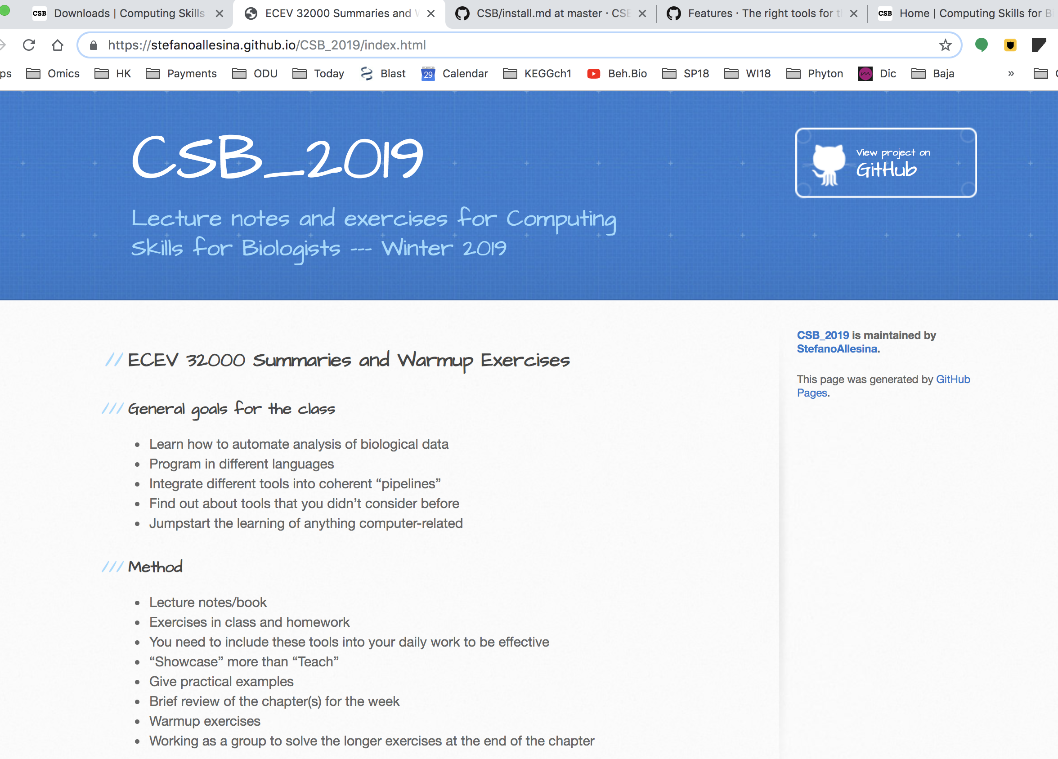

https://stefanoallesina.github.io/CSB_2019/index.html
Computing Skills
for Biologist

Slide 8
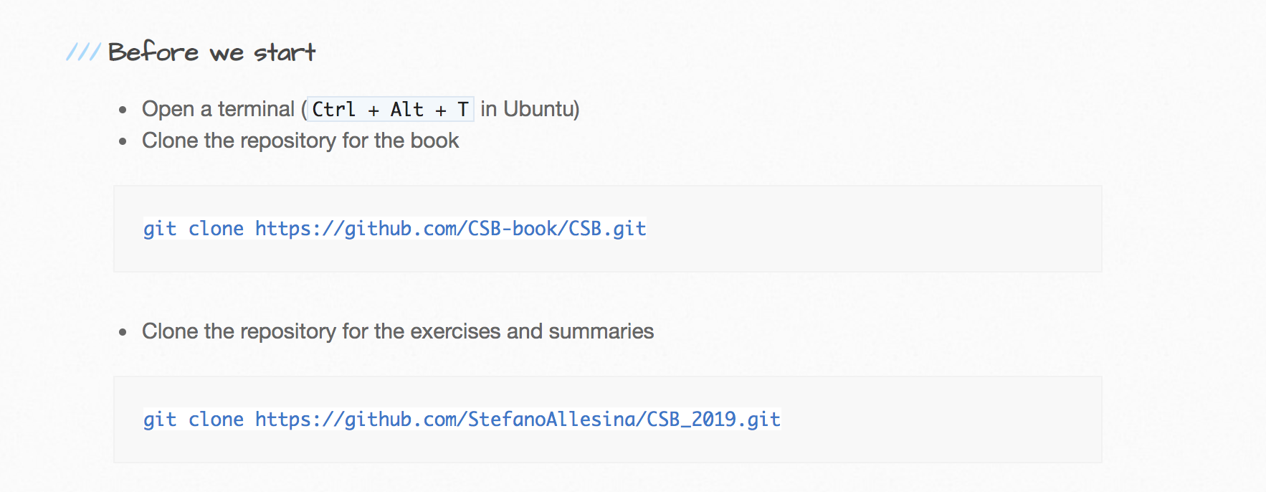
Get code online

Slide 9
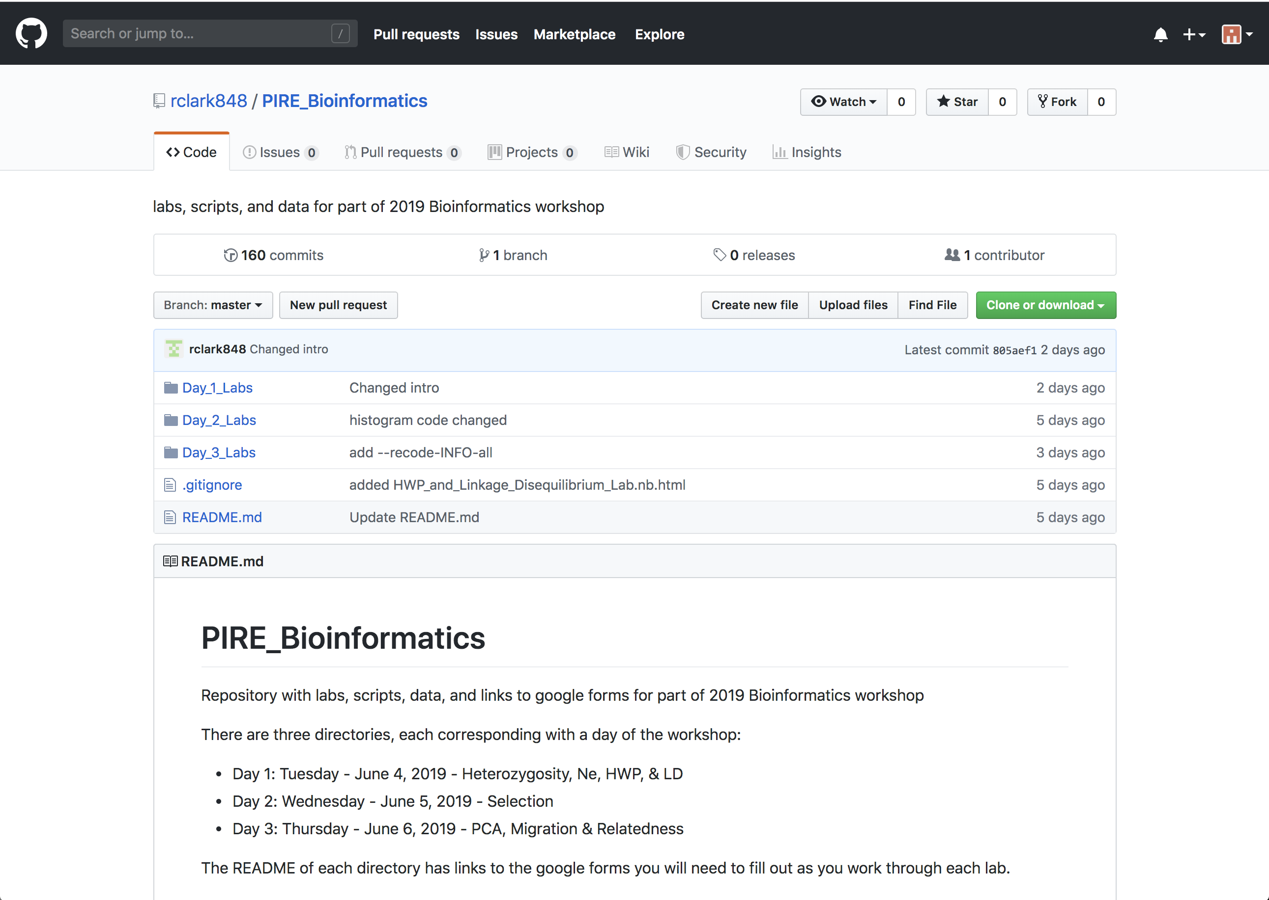
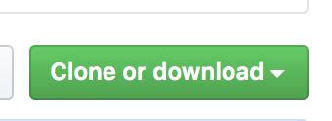

Slide 10
Flow of the Code
Create your code
Bash
Python
R
Manage your code
Git : Control version
Share your code
GitHub
Get code online
GitHub
Other Sources

Slide 11
Git: Version Control System
Create your code
Bash
Python
R
Manage your code
Git : Version Contol
Share your code
GitHub
Get code online
GitHub
Other Sources

Slide 12
Git: Version Control System
Repository
Code
change 1
change 2
Vo
Vo
Vo
V1
V2
V3
Final Code

Slide 13
Git : commands
init
Code
Repository

Slide 14
Git : commands
init
Code
Repository
add
Modify your code till you have reach a landmark
Vo

Slide 15
Git : commands
init
Code
Repository
add
commit
commit
Modify your code till you have reach a landmark
Vo
Snapshot of project
Records who, what, when & why

Slide 16
Git : commands
init
Code
Repository
add
commit
commit
Modify your code till you have reach a landmark
Vo
Snapshot of project
Records who, what, when & why
V2
V3
Diversify
Experiment
V1
V2

Slide 17
Git : commands
init
Code
Repository
add
commit
commit
Modify your code till you have reach a landmark
Vo
Snapshot of project
Records who, what, when & why
branching
Diversify
Experiment
branching
V2
V3
V1
V2
Organized versions
Work with other people

Slide 18
Git : commands
init
Code
Repository
add
commit
commit
Modify your code till you have reach a landmark
Vo
Snapshot of project
Records who, what, when & why
branching
Diversify
Experiment
branching
V2
V3
V1
V2
Organized versions
Work with other people
Final Code
Consolidate
Final Code

Slide 19
Git : commands
init
Code
Repository
add
commit
commit
Modify your code till you have reach a landmark
Vo
Snapshot of project
Records who, what, when & why
branching
Diversify
Experiment
branching
V2
V3
V1
V2
Organized versions
Work with other people
merge
merge
Final Code
Consolidate
Final Code
Create final code(s)

Slide 20
Git : commands
init
Code
Repository
add
commit
commit
Modify your code till you have reach a landmark
Vo
Snapshot of project
Records who, what, when & why
branching
Diversify
Experiment
branching
V2
V3
V1
V2
Organized versions
Work with other people
merge
merge
Final Code
Consolidate
Final Code
Create final code(s)

Slide 21
What are the Commands?
Repository
Code

Slide 22
What are the Commands?
init
Repository
Code

Slide 23
What are the Commands?
init
Repository
Code
Vo

Slide 24
What are the Commands?
init
Repository
Code
add
Vo

Slide 25
What are the Commands?
init
Repository
Code
add
change 1
change 2
commit
Vo
Vo
Vo

Slide 26
What are the Commands?
init
Repository
Code
add
commit
Vo
Vo
Vo
V2
V3
V1
V2

Slide 27
What are the Commands?
init
Repository
Code
add
commit
Vo
Vo
Vo
branching
V2
V3
V1
V2

Slide 28
What are the Commands?
init
Repository
Code
add
commit
Vo
Vo
Vo
branching
V2
V3
V1
V2
Final Code

Slide 29
What are the Commands?
init
Repository
Code
add
commit
Vo
Vo
Vo
branching
V1
V2
V3
merge
Final Code

Slide 30
What are the Commands?
init
Repository
Code
add
commit
Vo
Vo
Vo
branching
V1
V2
V3
merge
Final Code

Slide 31
Why Use Version Control?

Slide 32
Why Use Version Control?
Organized
Automated
Reproducible
Easy to read
Easy to share
CODE

Slide 33
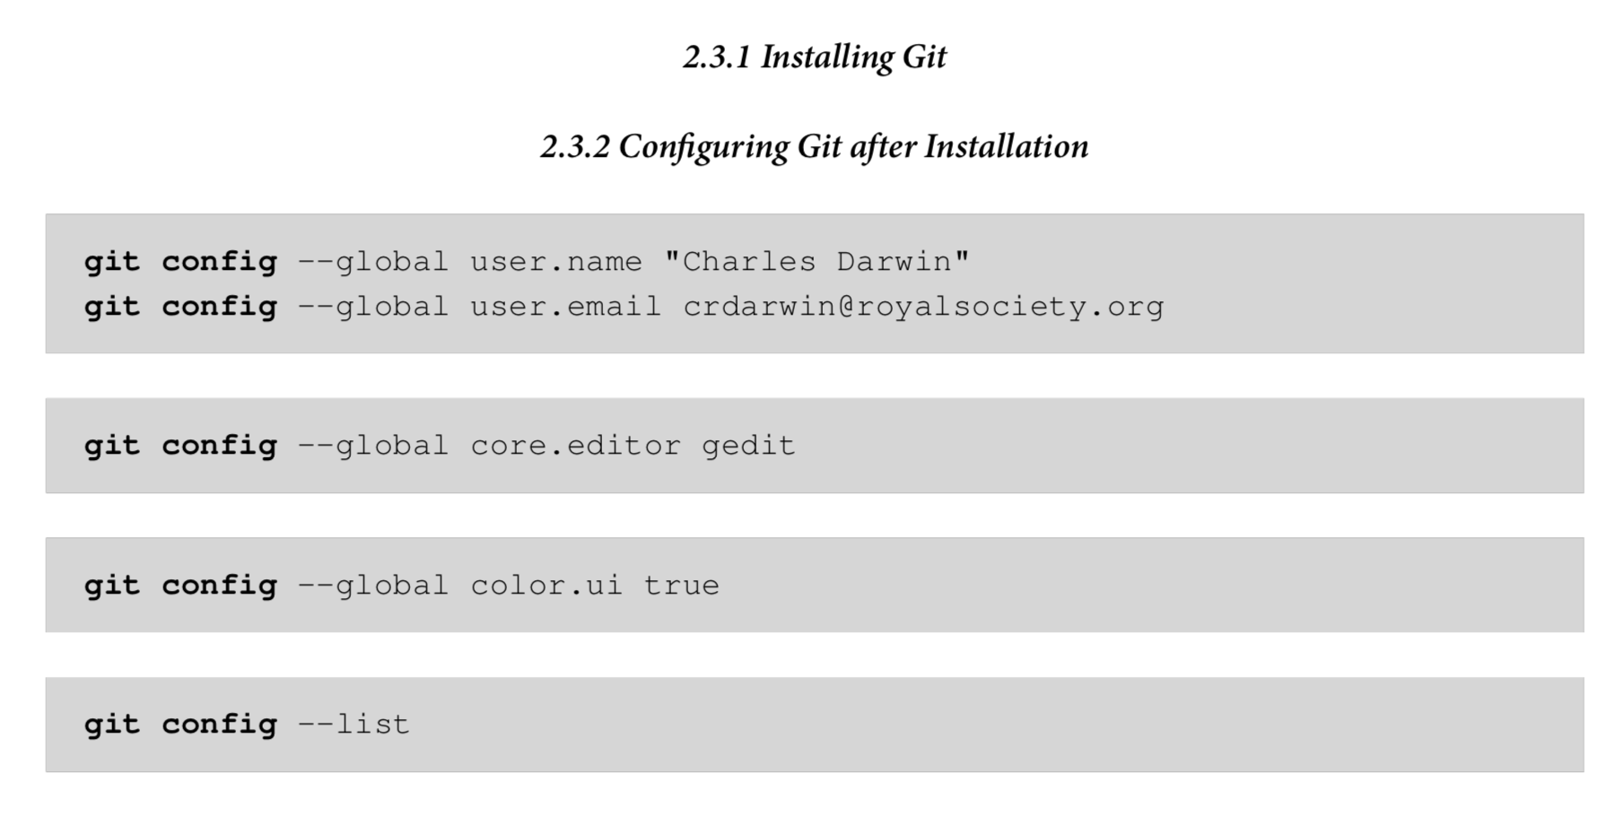
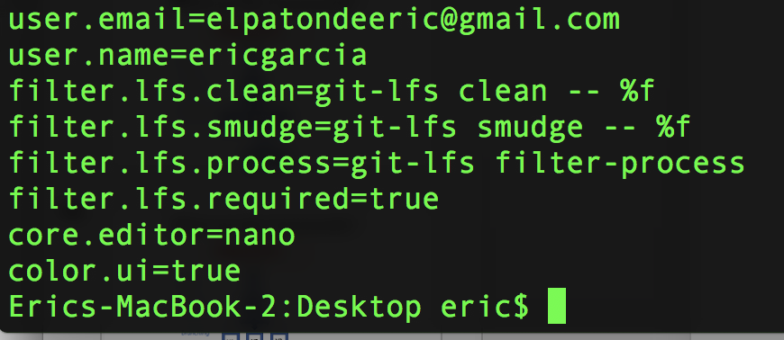
Configuring
Git

Slide 34
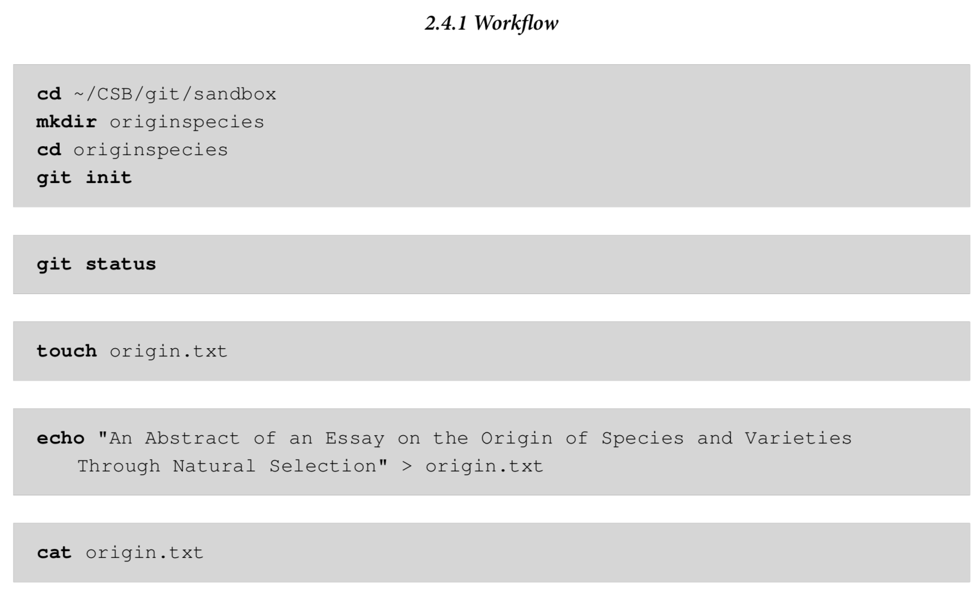
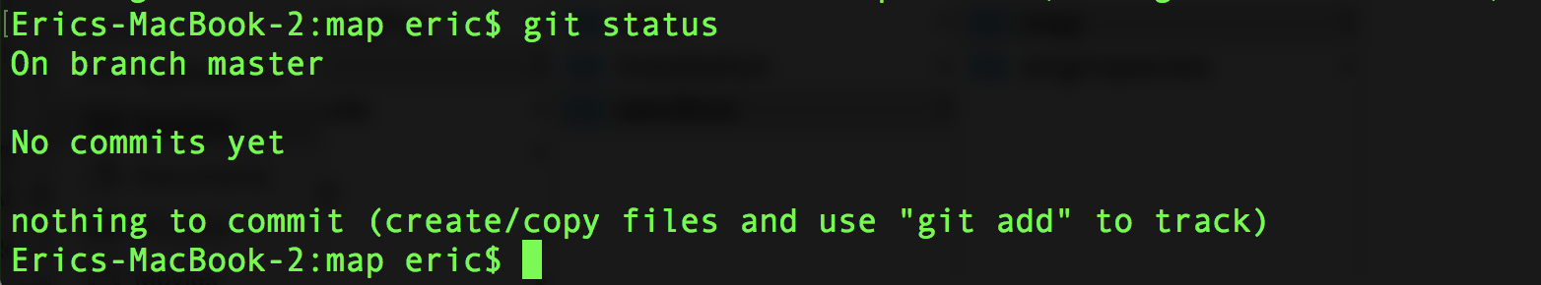
cd ~/CSB/git/sandbox
mkdir map
cd map
git init

Slide 35
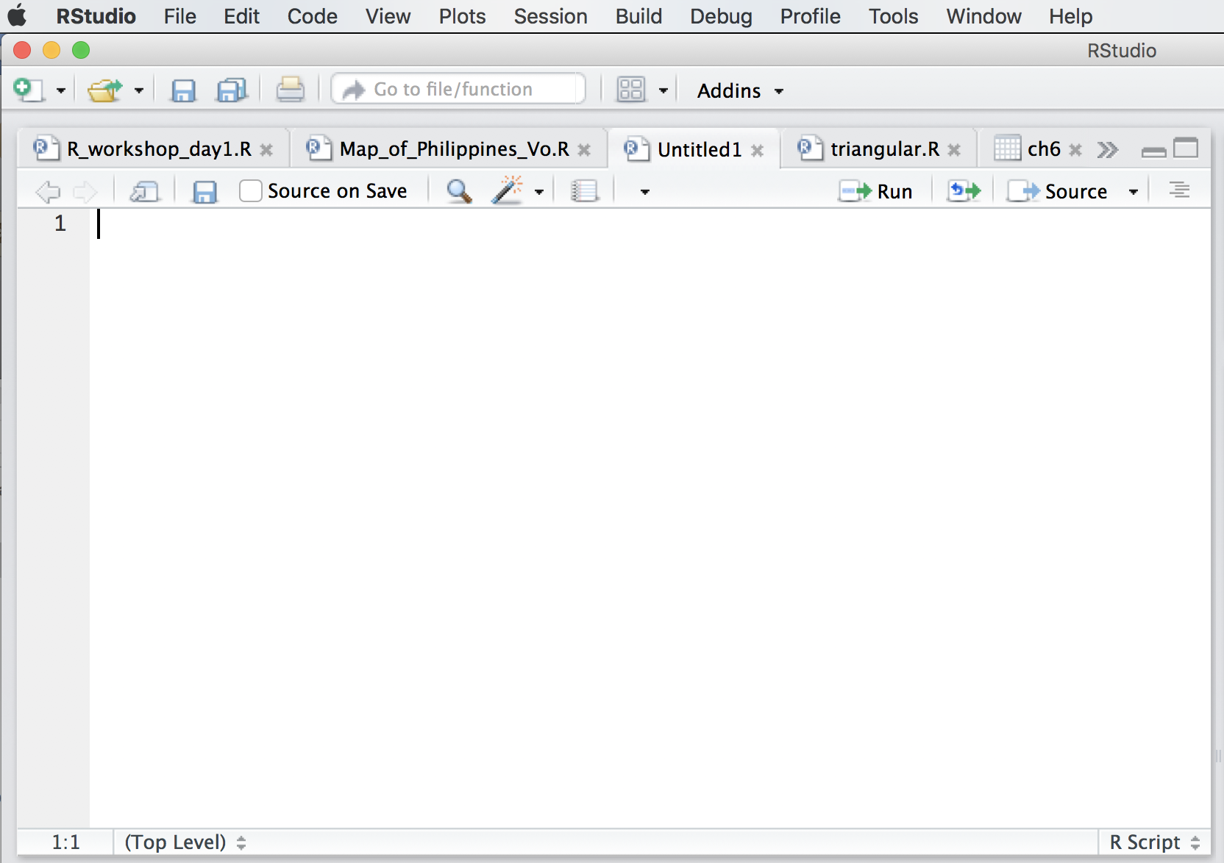
Lets make a map for the Philippines!
OPEN Rstudio: Open a new .R script
File > New File > R Script

Slide 36
R Packages & Libraries
Does anybody know why a package name must be in quotes when installing it, but should not be in quotes when loading it with library()?
A package is a collection of R code, data, and functions that have been made publicly available
There are over 14,000 R packages
Packages must be installed
install.packages(“name_of_pkg”)
Once installed, packages must be loaded
library(name_of_pkg)
Where to find packages specialized for your research questions
https://cran.r-project.org/web/views/
https://github.com/
https://www.bioconductor.org/
Making packages
R Studio
http://r-pkgs.had.co.nz/

Slide 37
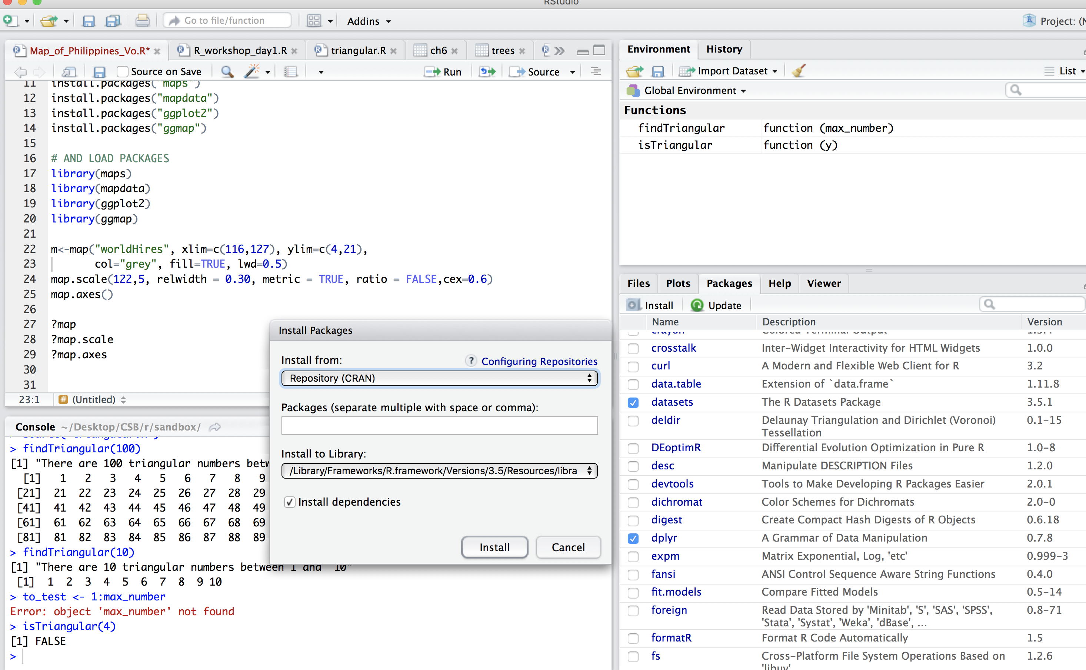

Slide 38
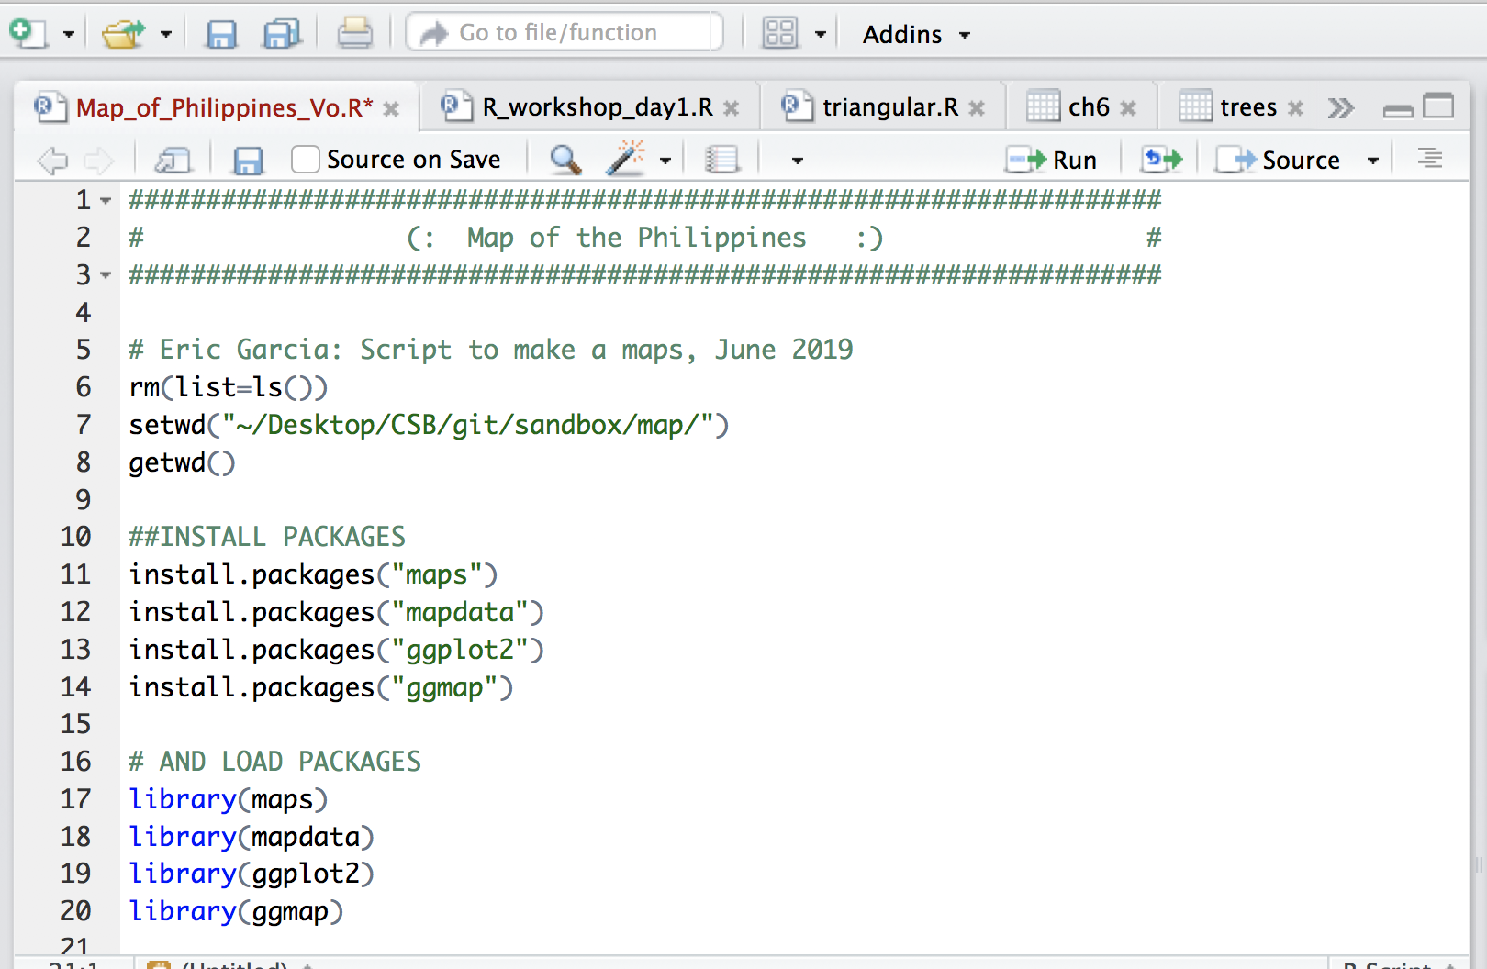
Lets make a map for the Philippines!
save it to:
~/CSB/git/sandbox/map

Slide 39
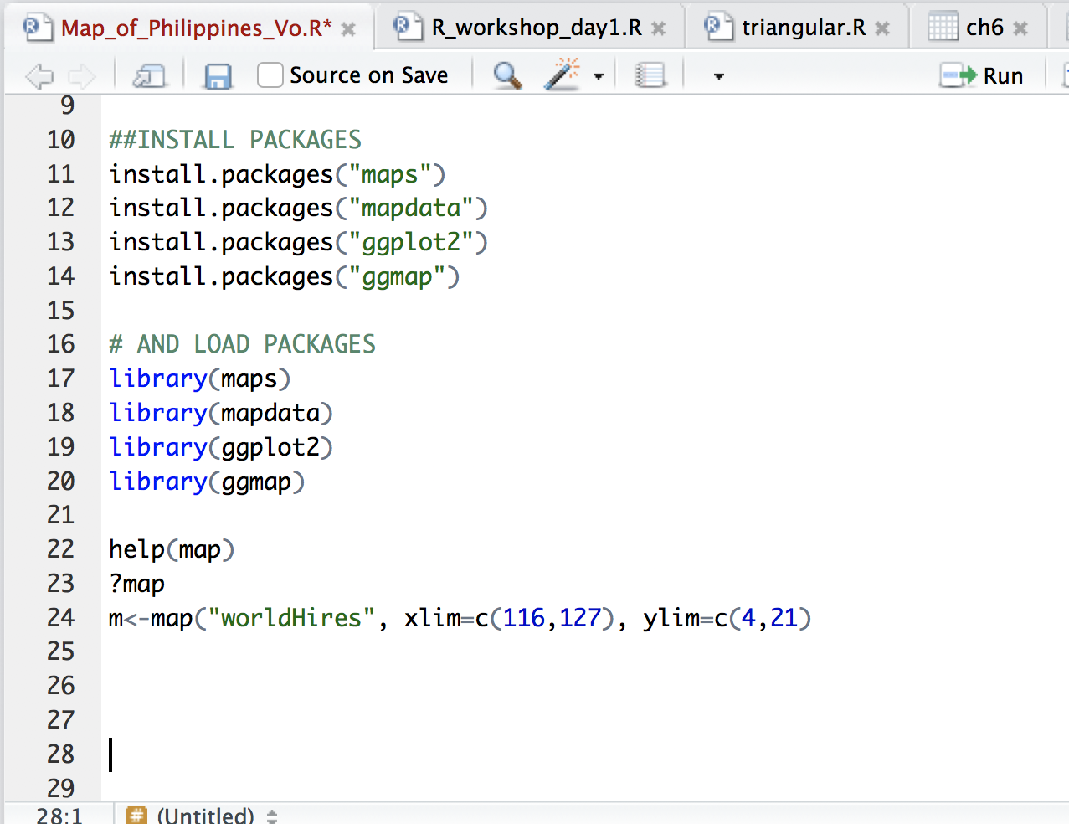
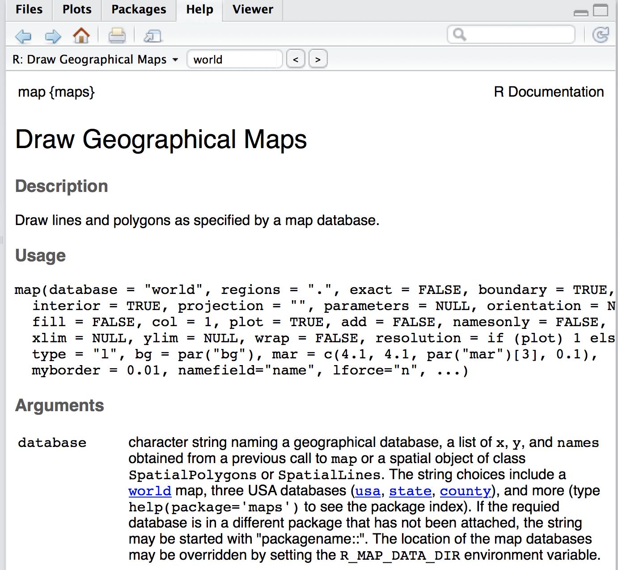
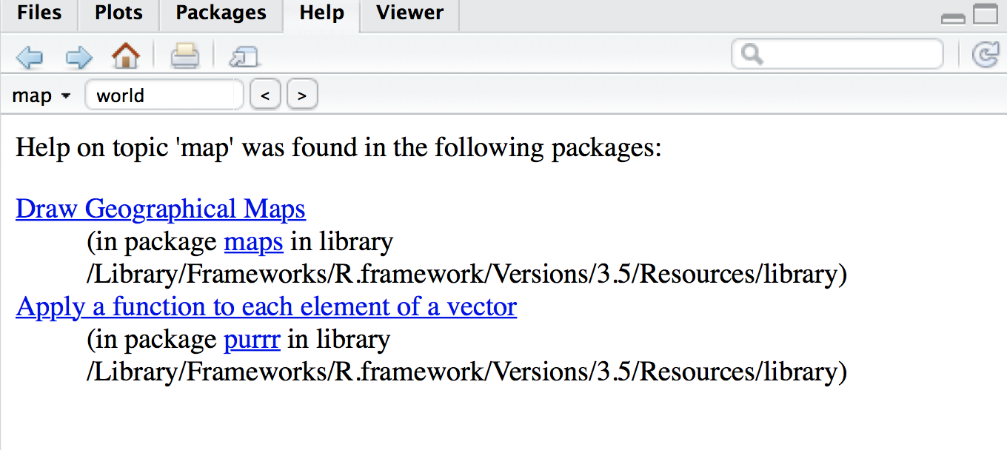
Lets make a map for the Philippines!
HELP
save it to:
~/CSB/git/sandbox/map

Slide 40

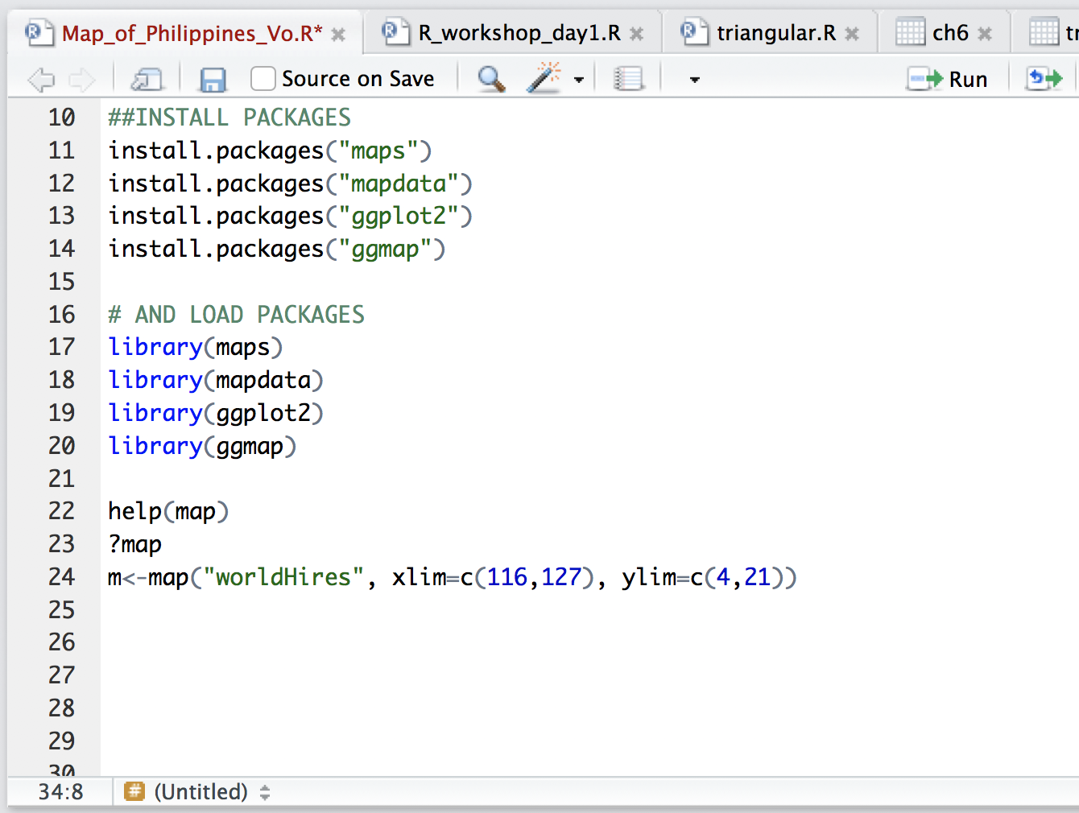
Lets make a map for the Philippines!

Slide 41
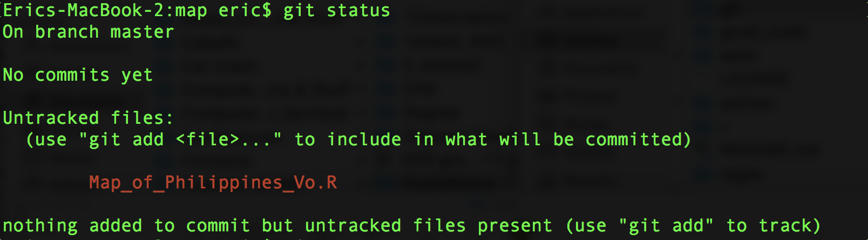

Slide 42
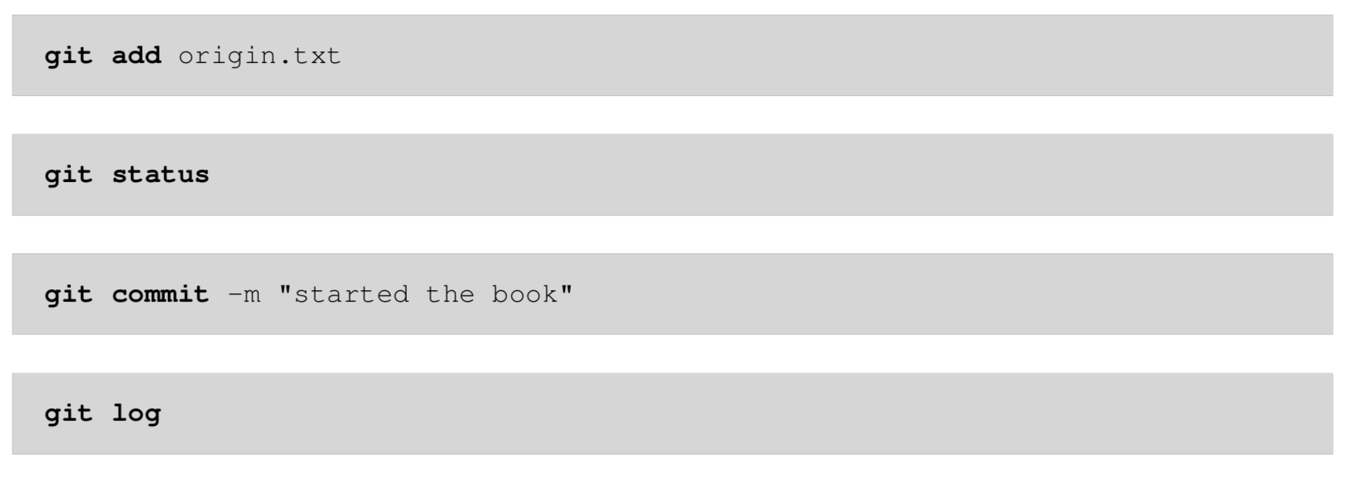
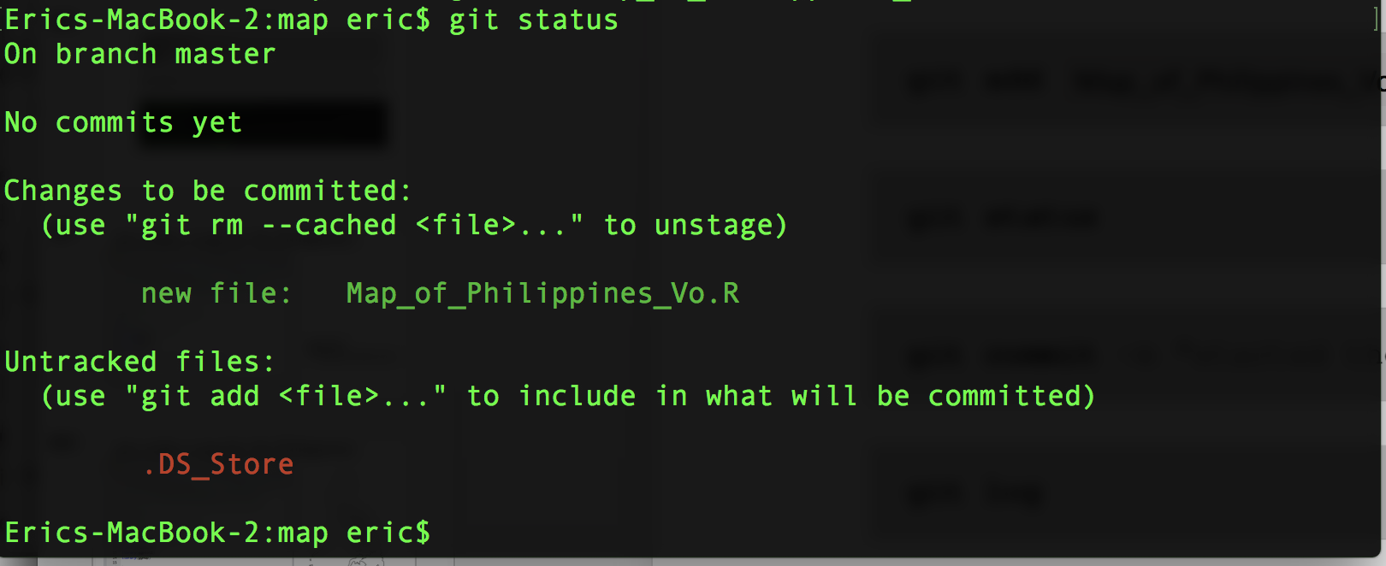
Map_of_Philippines_Vo.R

Slide 43
Map_of_Philippines_Vo.R
.
git add
(for all files)
to add all filies use = git add .

Slide 44
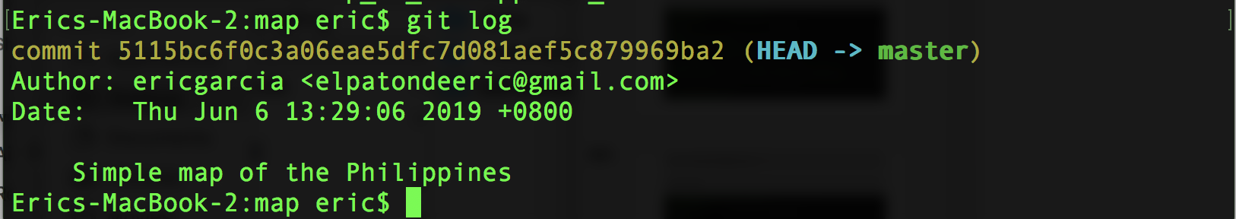
“Simple map of the Philippines”

Slide 45

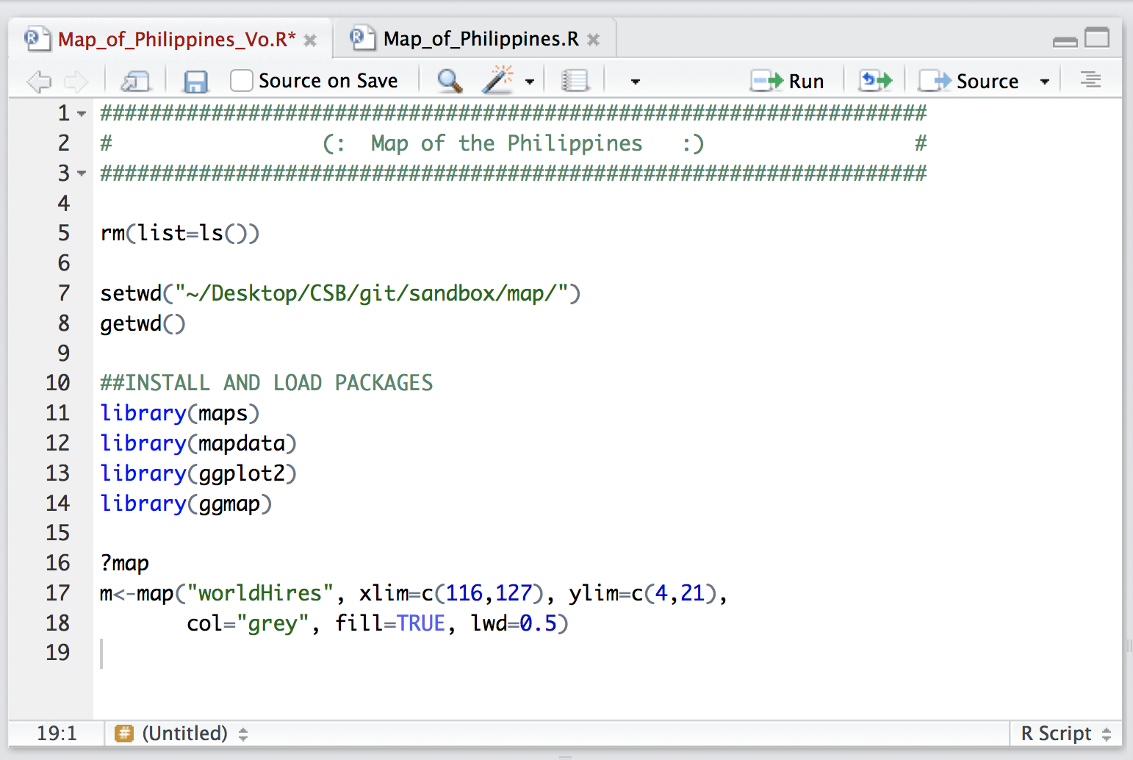
Lets make a map for the Philippines!

Slide 46
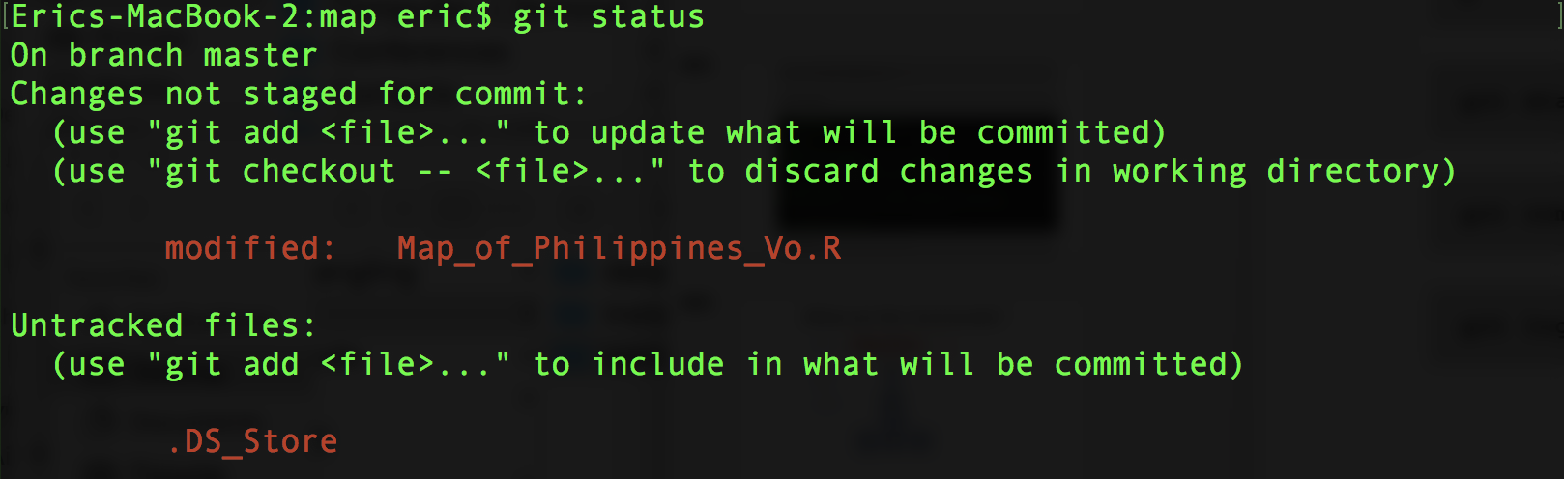

Slide 47
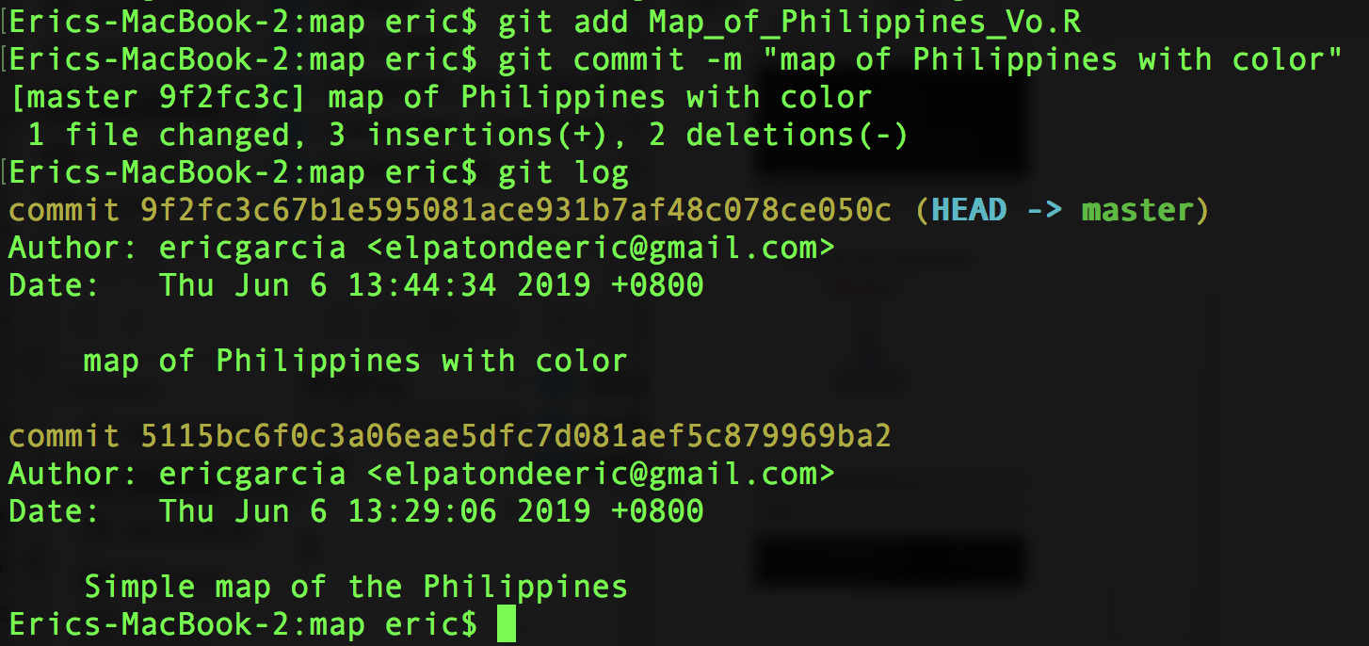
“map of the Philippines with color”
Map_of_Philippines_Vo.R
“map of the Philippines with color”

Slide 48
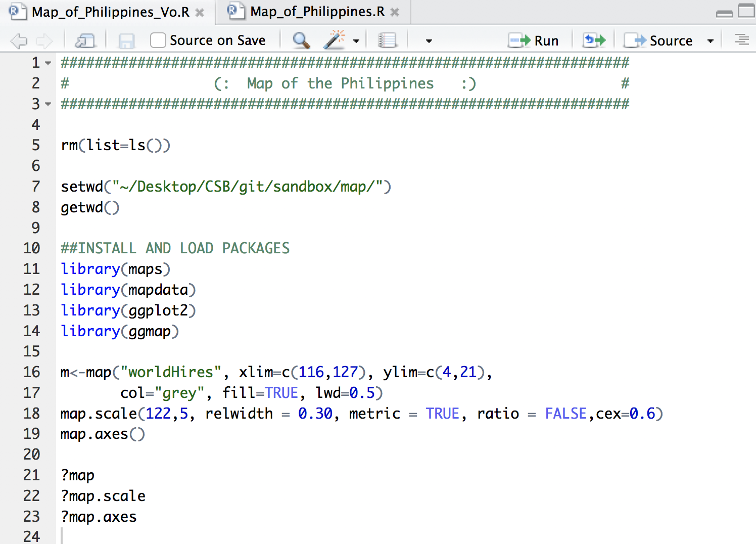
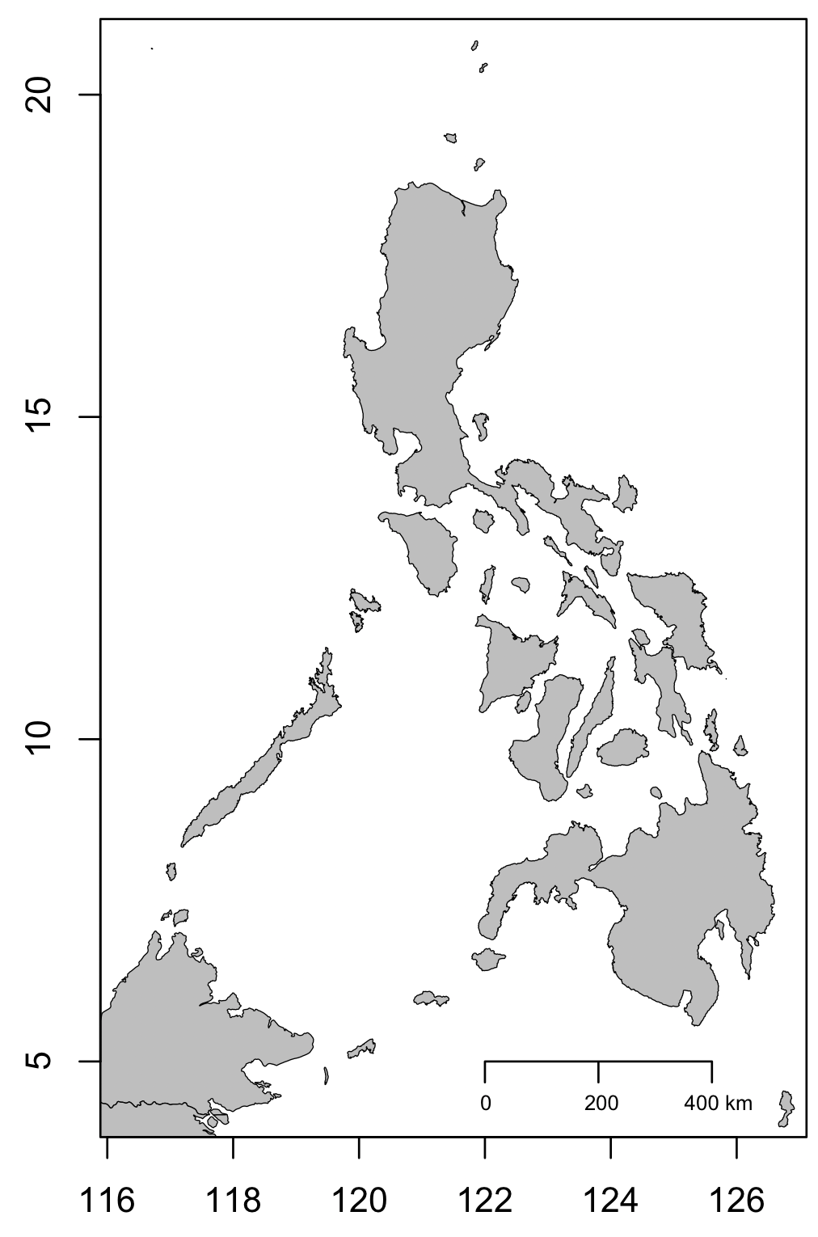
Yeah, a map for the Philippines!
git add “file”
git commit –m “message”

Slide 49
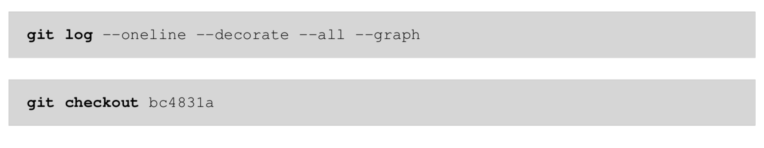
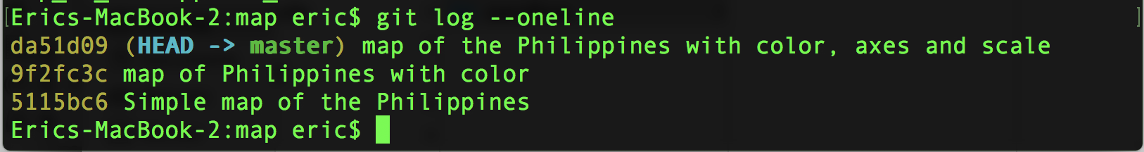
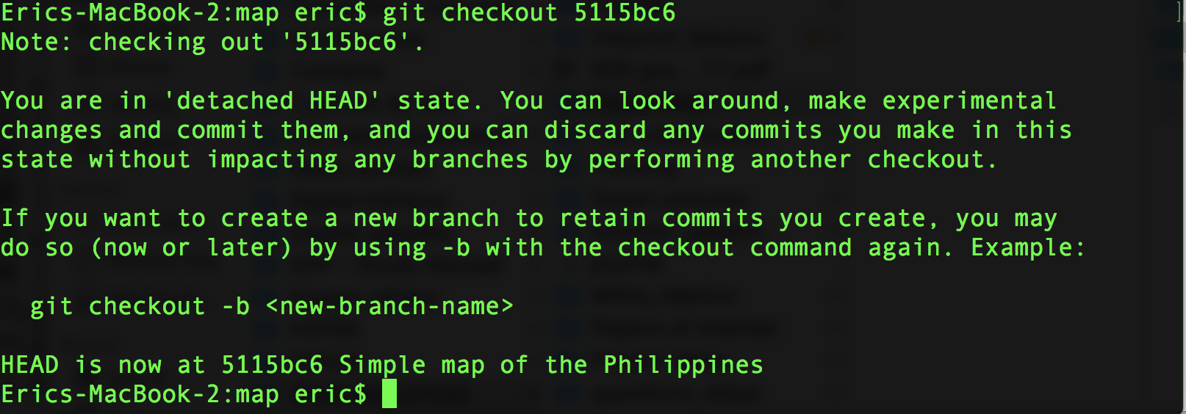
5115bc6

Slide 50
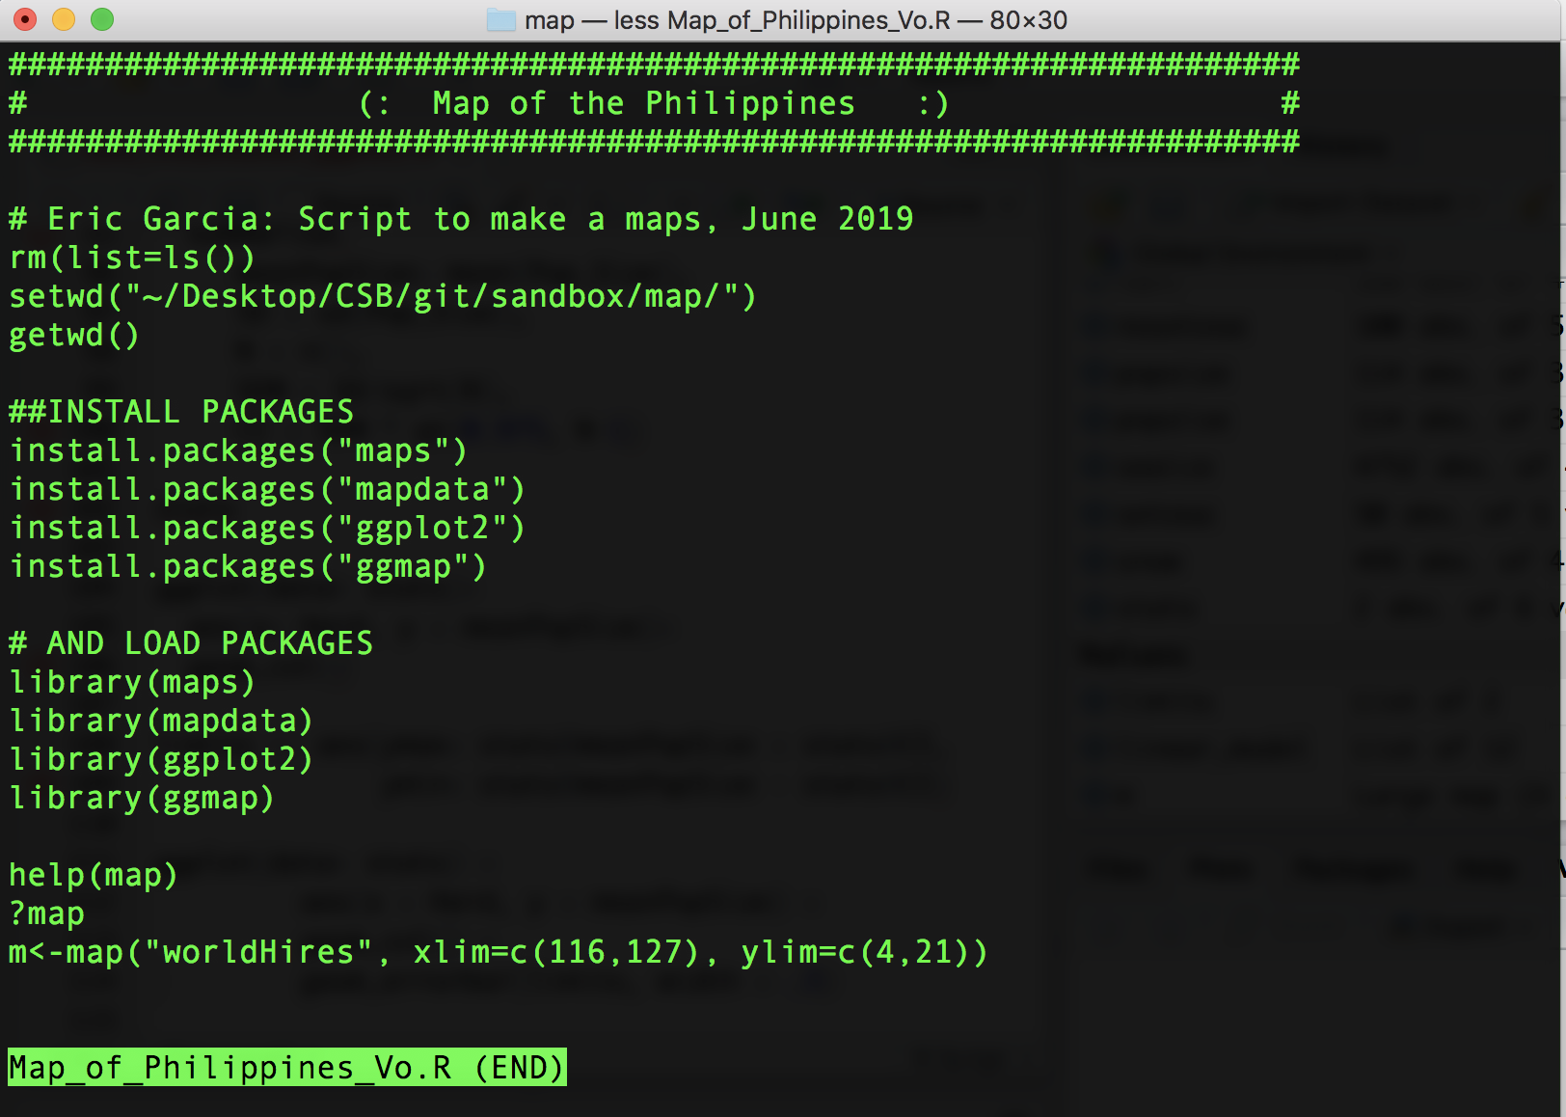
less Map_of_Philippines_Vo.R

Slide 51
master
less Map_of_Philippines_Vo.R

Slide 52

master
less Map_of_Philippines_Vo.R

Slide 53
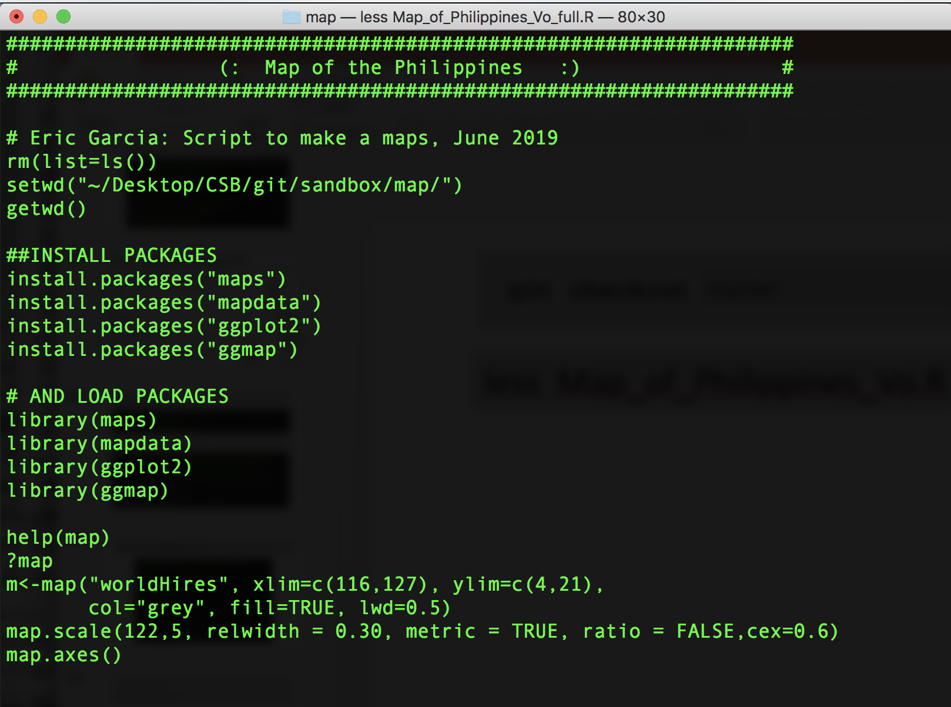
master
less Map_of_Philippines_Vo.R

Slide 54
Flow of the Code
Create your code
Bash
Python
R
Manage your code
Git : Control version
Share your code
GitHub
Get code online
GitHub
Other Sources

Slide 55
GitHub: Remote Repository
Create your code
Bash
Python
R
Manage your code
Git : Version Contol
Share your code
GitHub
Get code online
GitHub
Other Sources

Slide 56

GitHub
Remote Repository

Slide 57
GitHub
Remote Repository
clone
B1
User 1

Slide 58
GitHub
Remote Repository
B1
B1
B1
User 1

Slide 59
GitHub
Remote Repository
push
B1
B1
B1
User 1

Slide 60
GitHub
Remote Repository
pull
push
pull
B1
B1
B1
B2
B2
B2
B3
B3
B3
User 1
User 2
User 3

Slide 61
GitHub
Remote Repository
push
pull
push
pull
push
pull
B1
B1
B1
B2
B2
B2
B3
B3
B3
User 1
User 2
User 3

Slide 62
Remote Repository
https://github.com
Git: Version Control

Slide 63
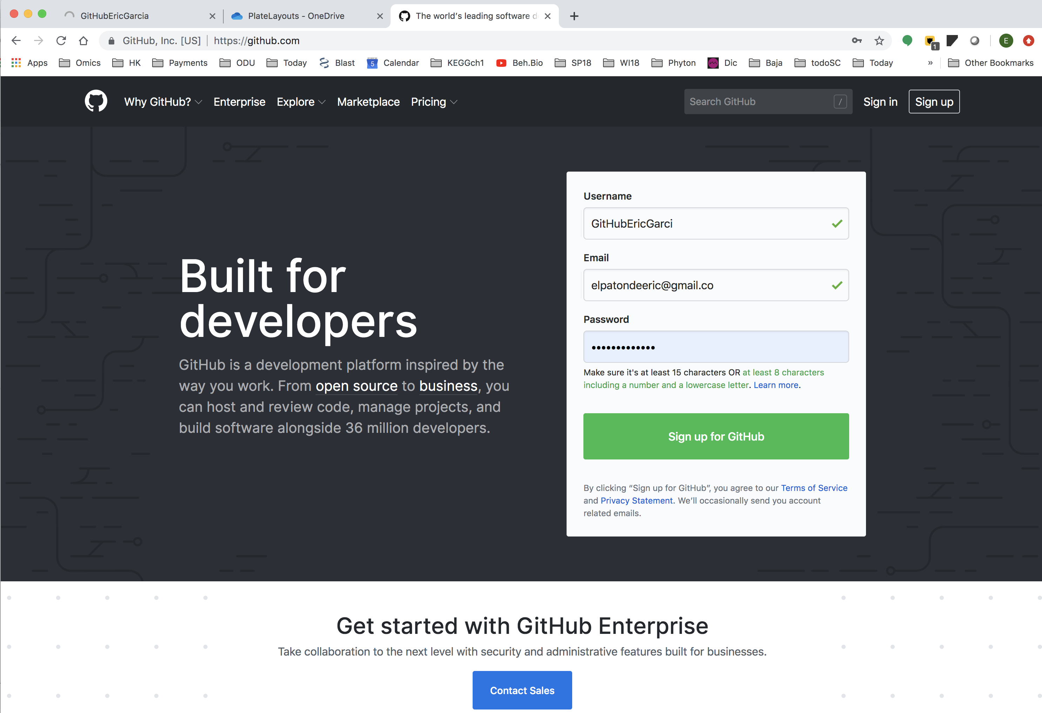

Slide 64
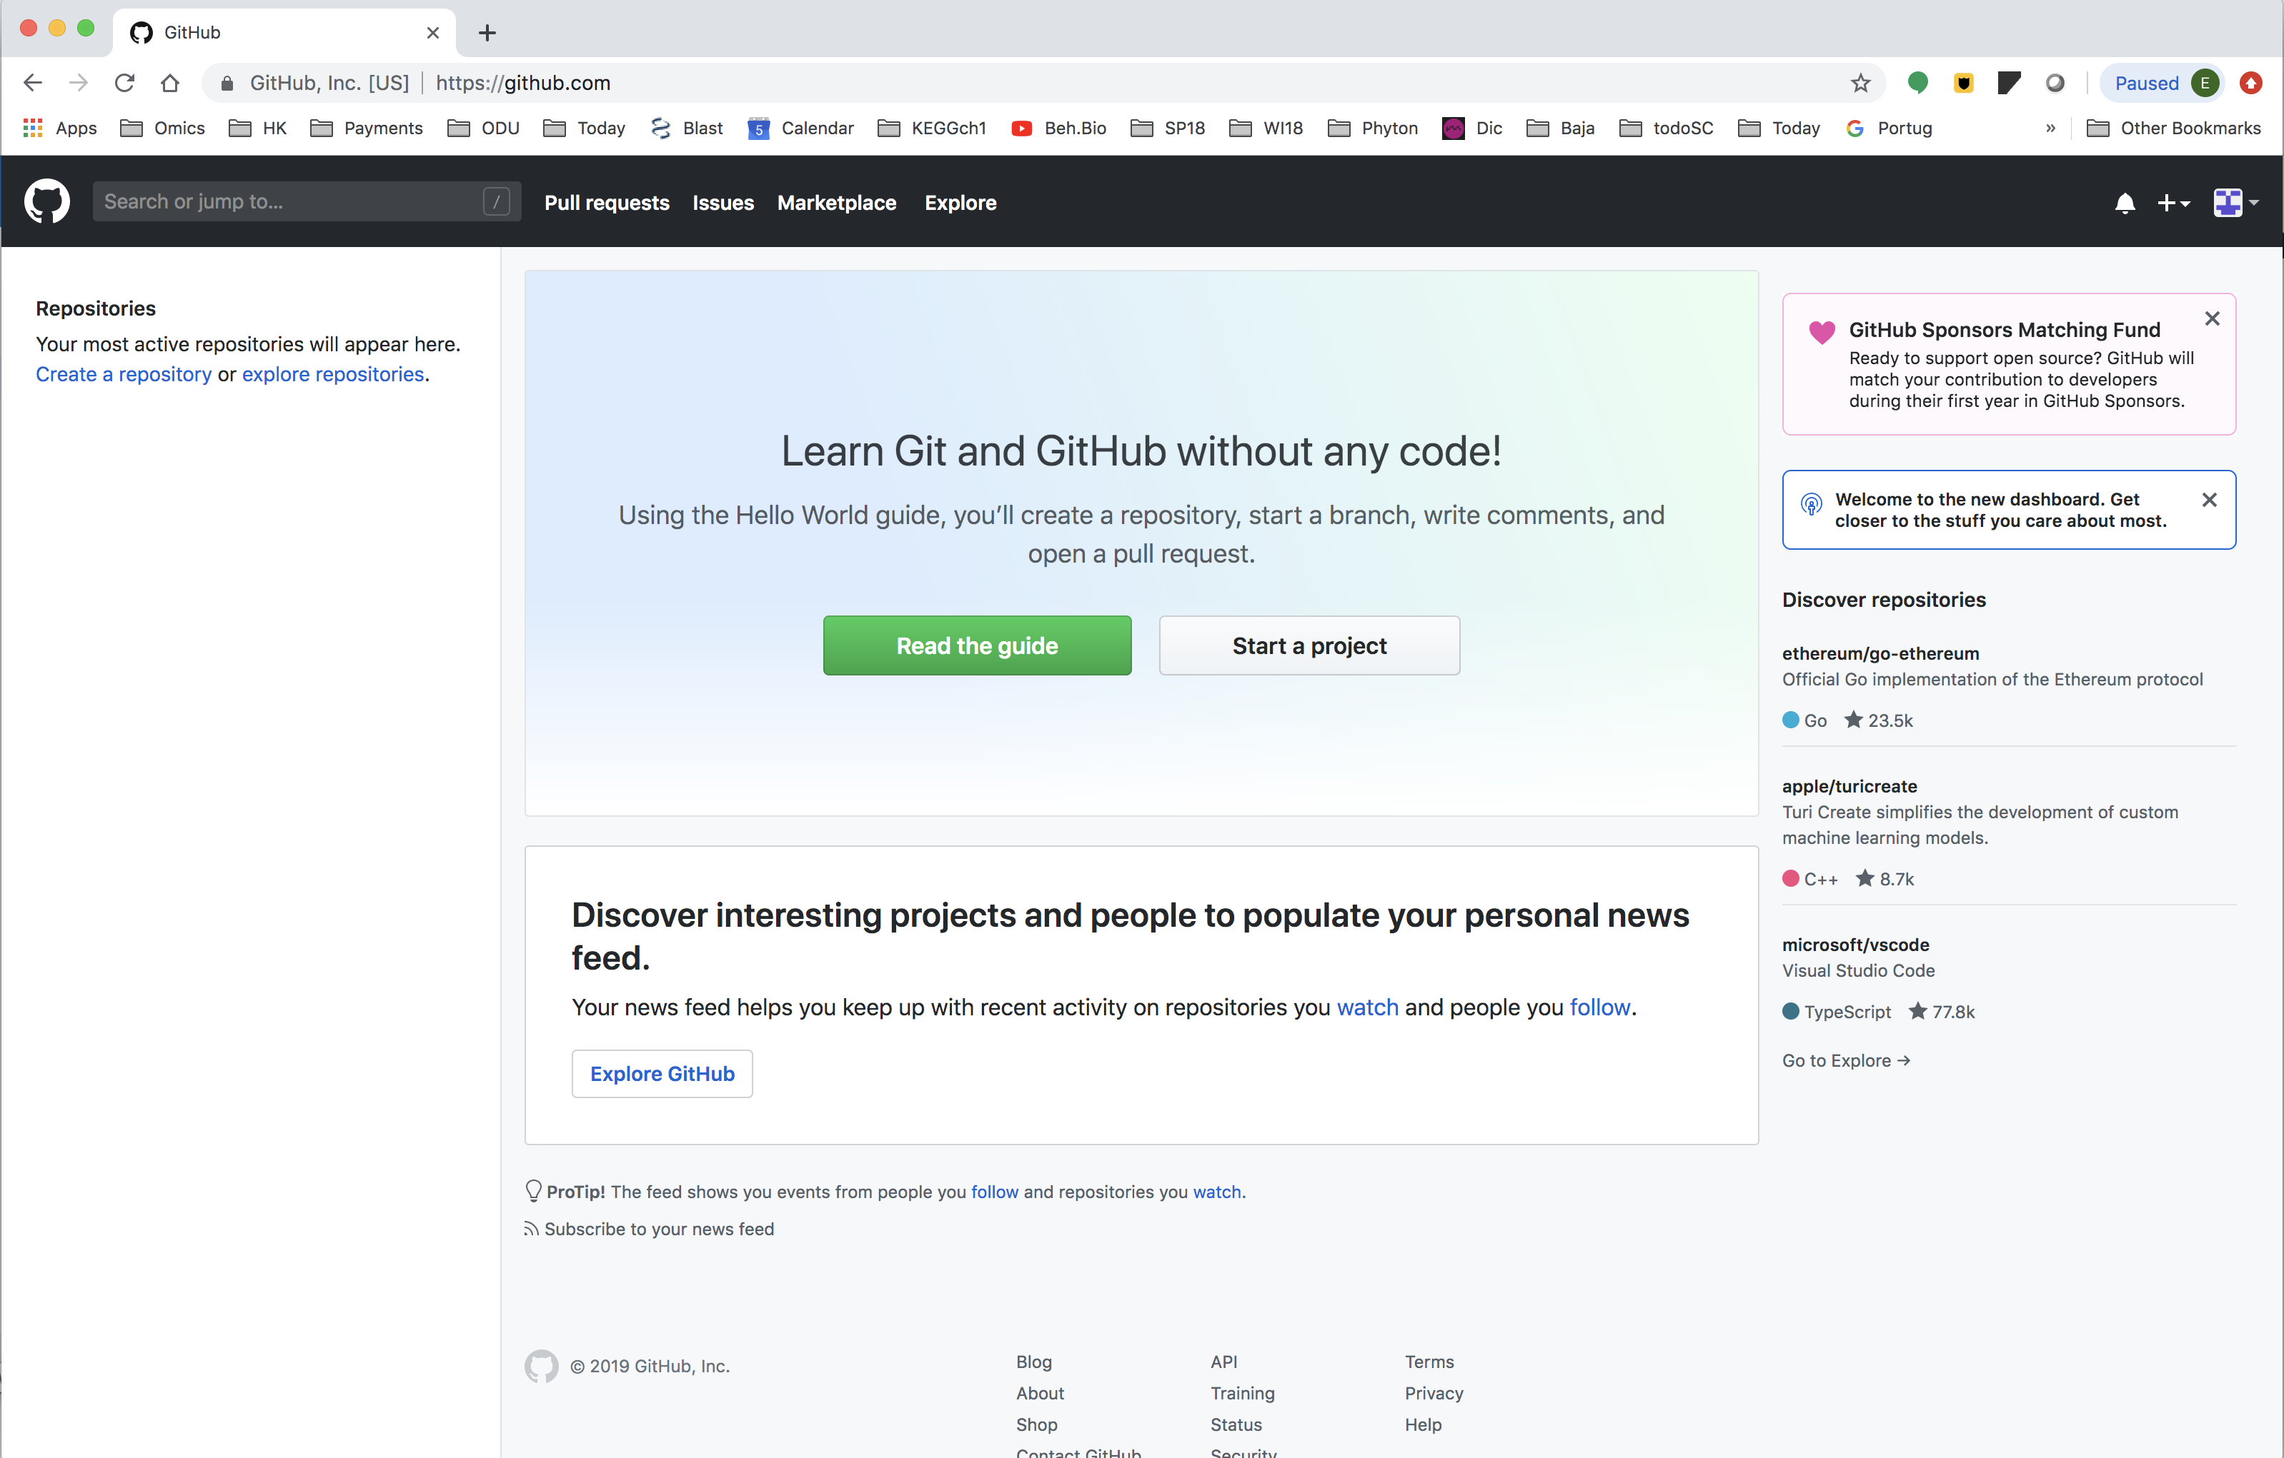

Slide 65
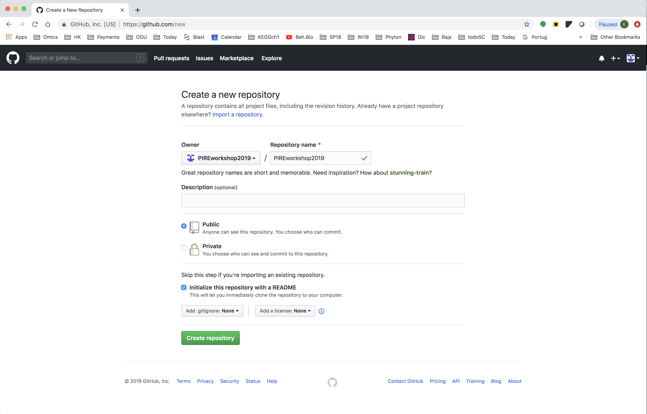

Slide 66
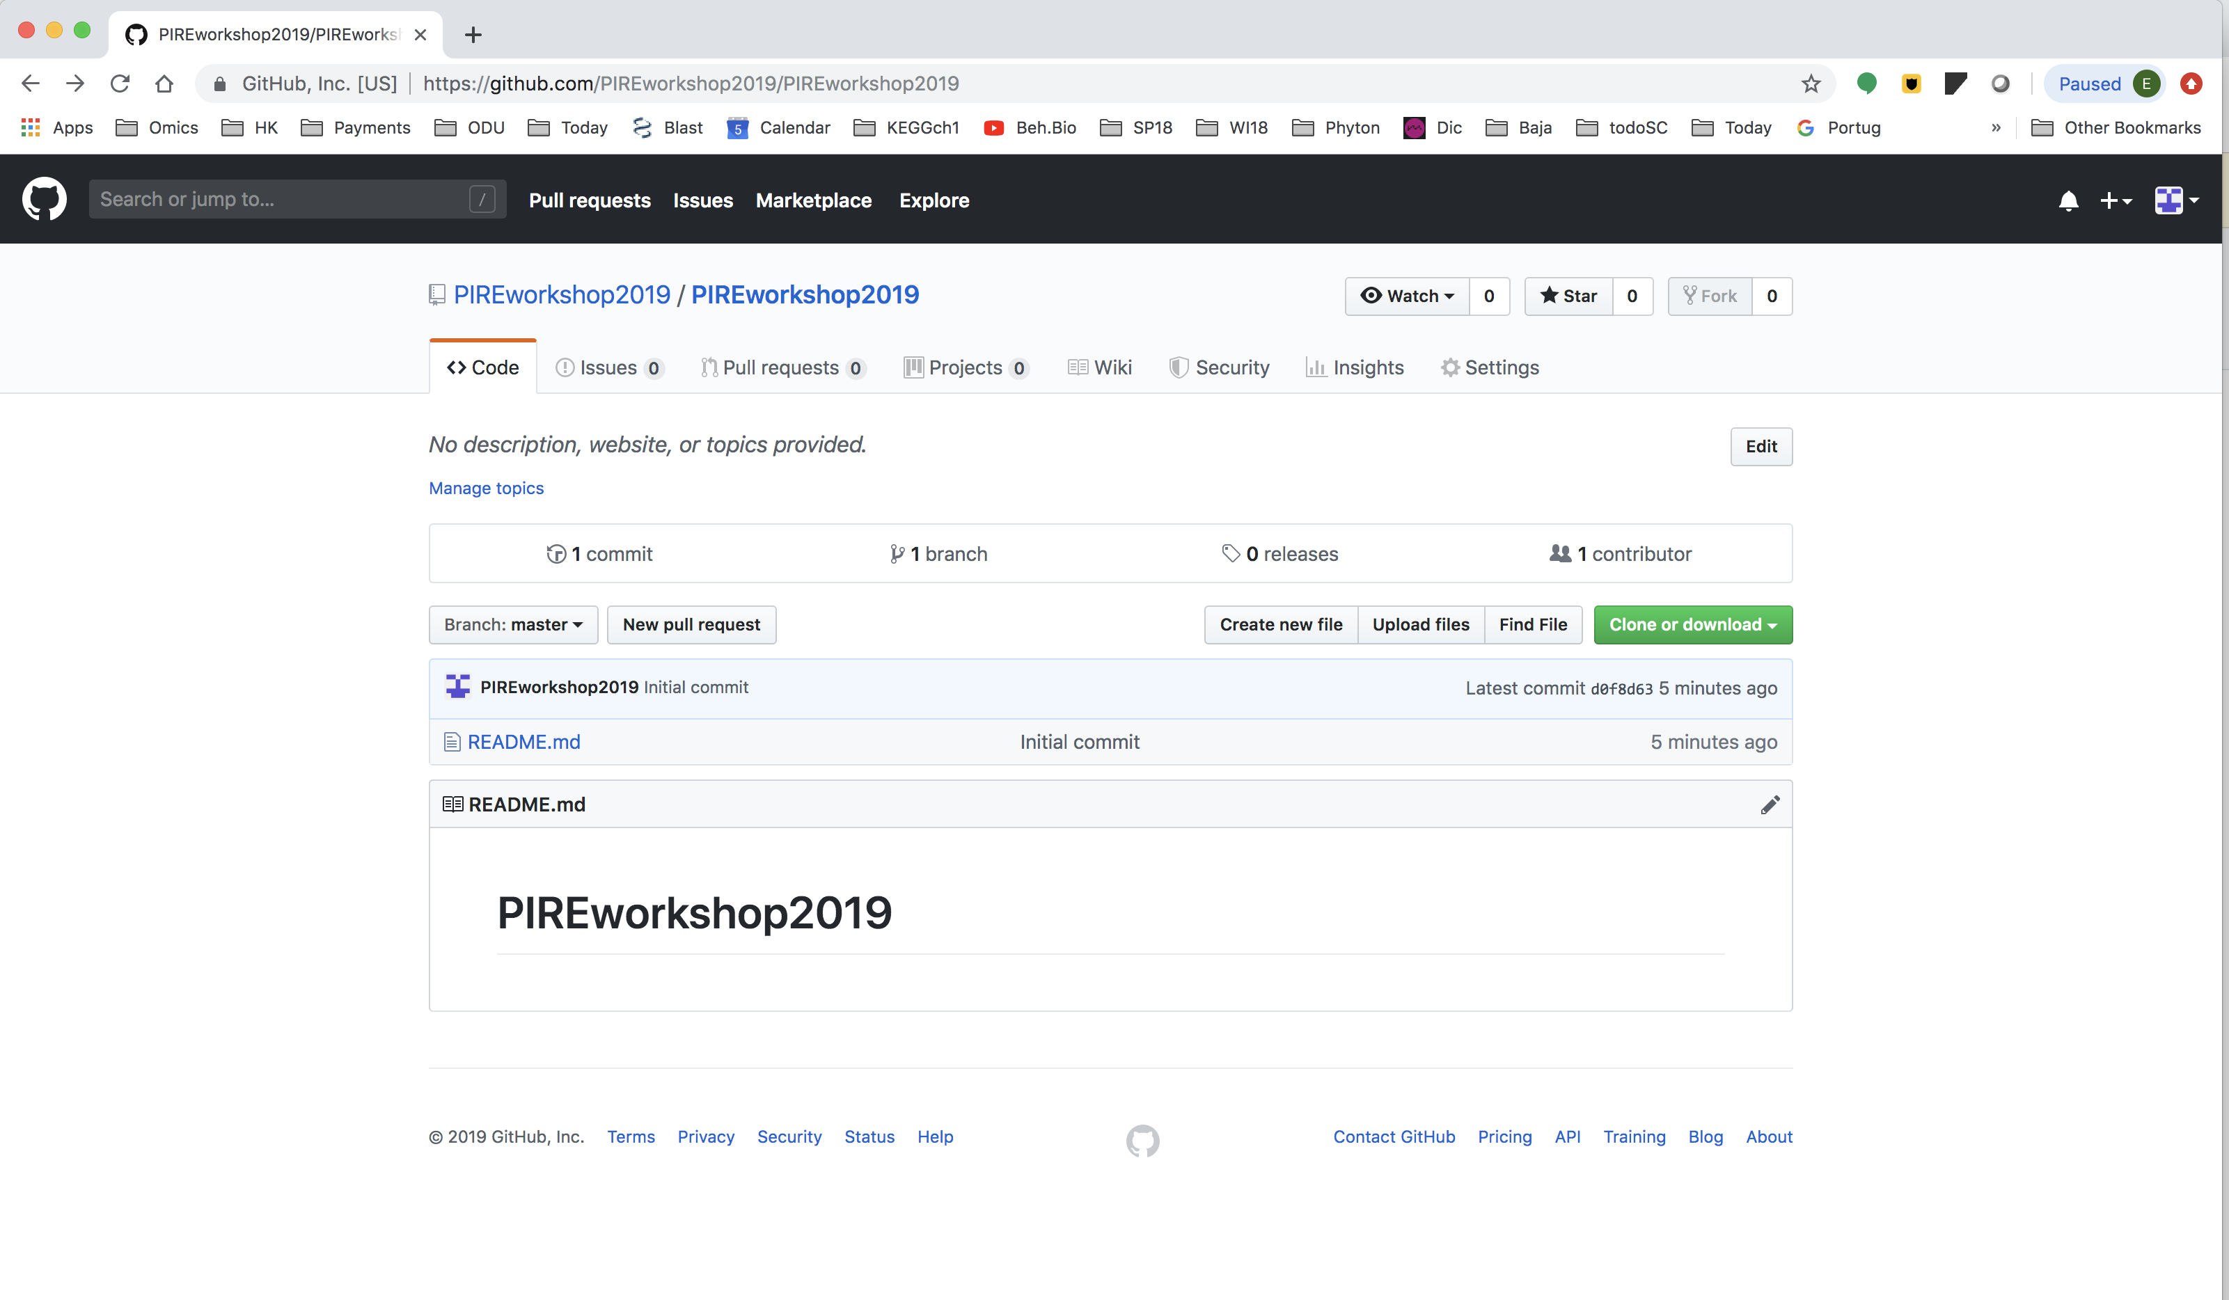

Slide 67
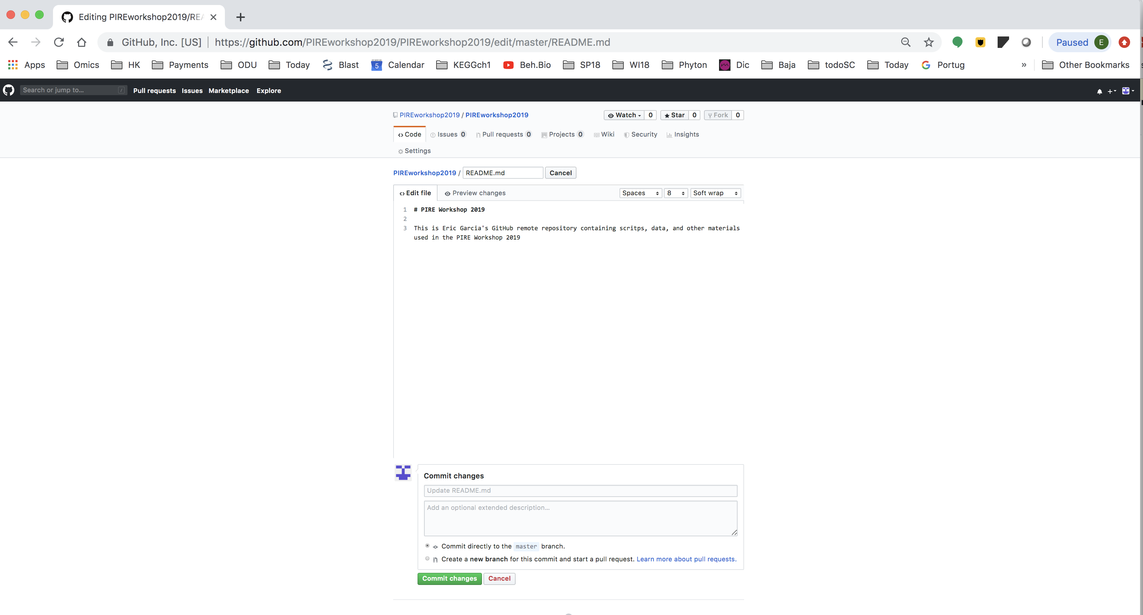

Slide 68
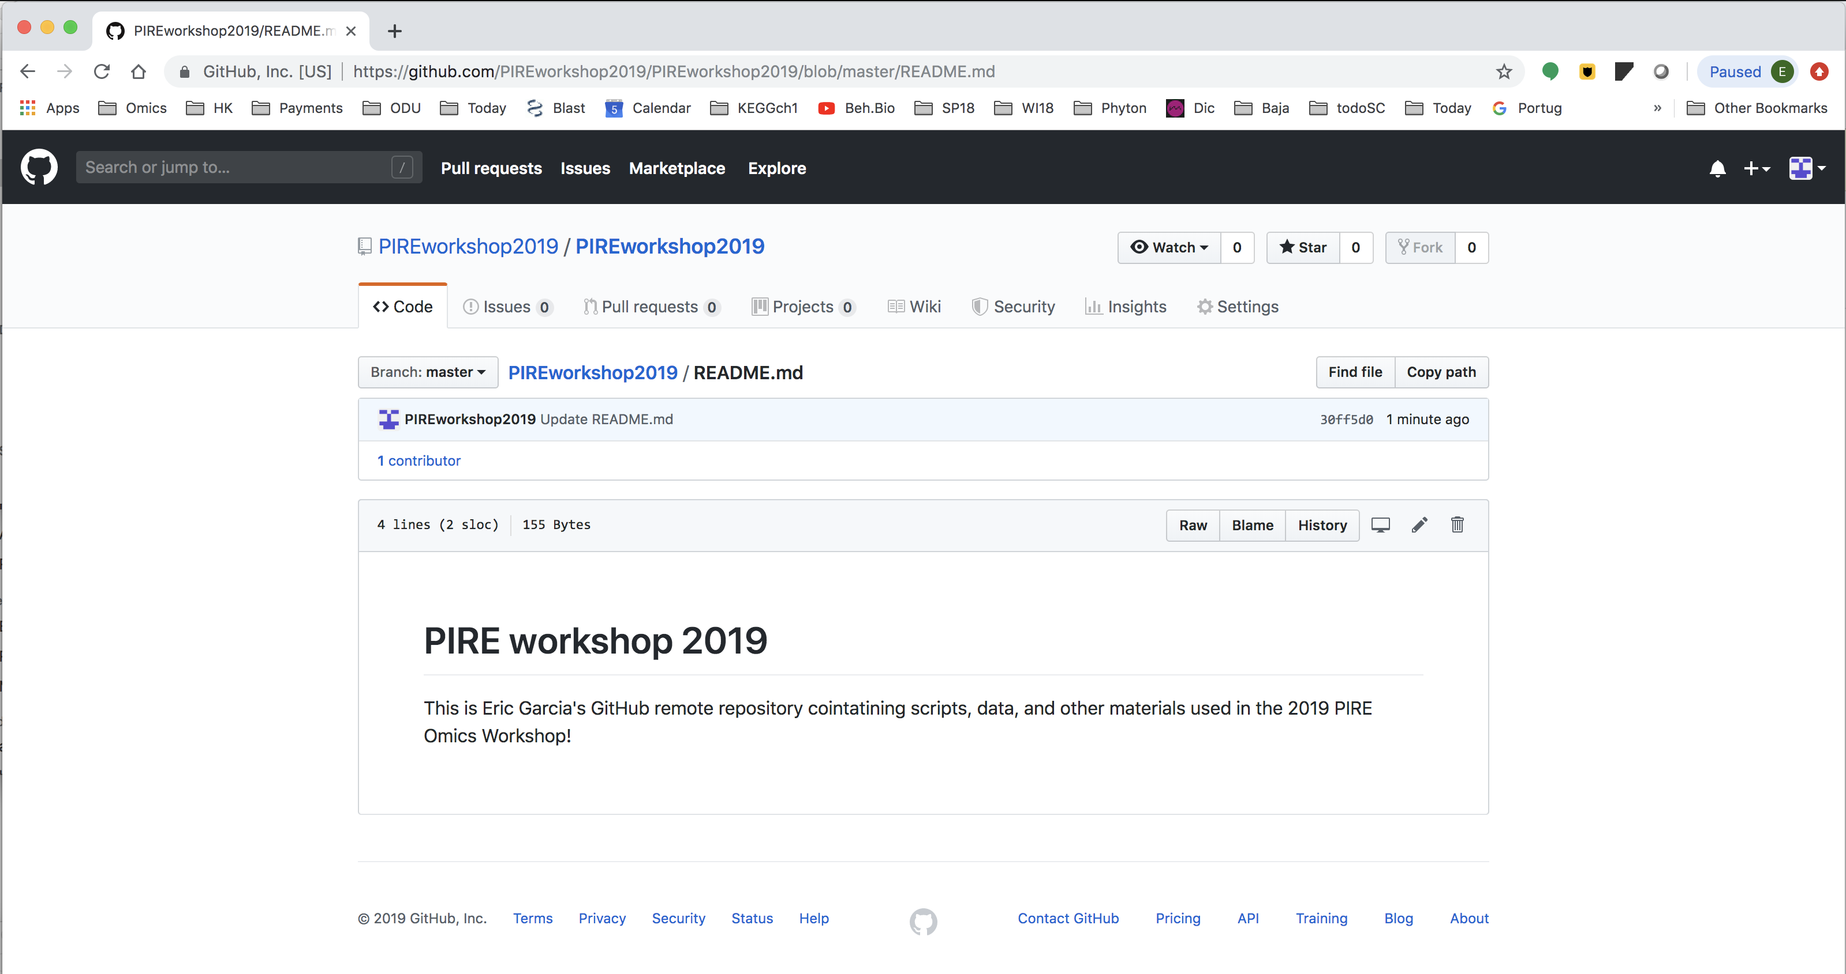

Slide 69
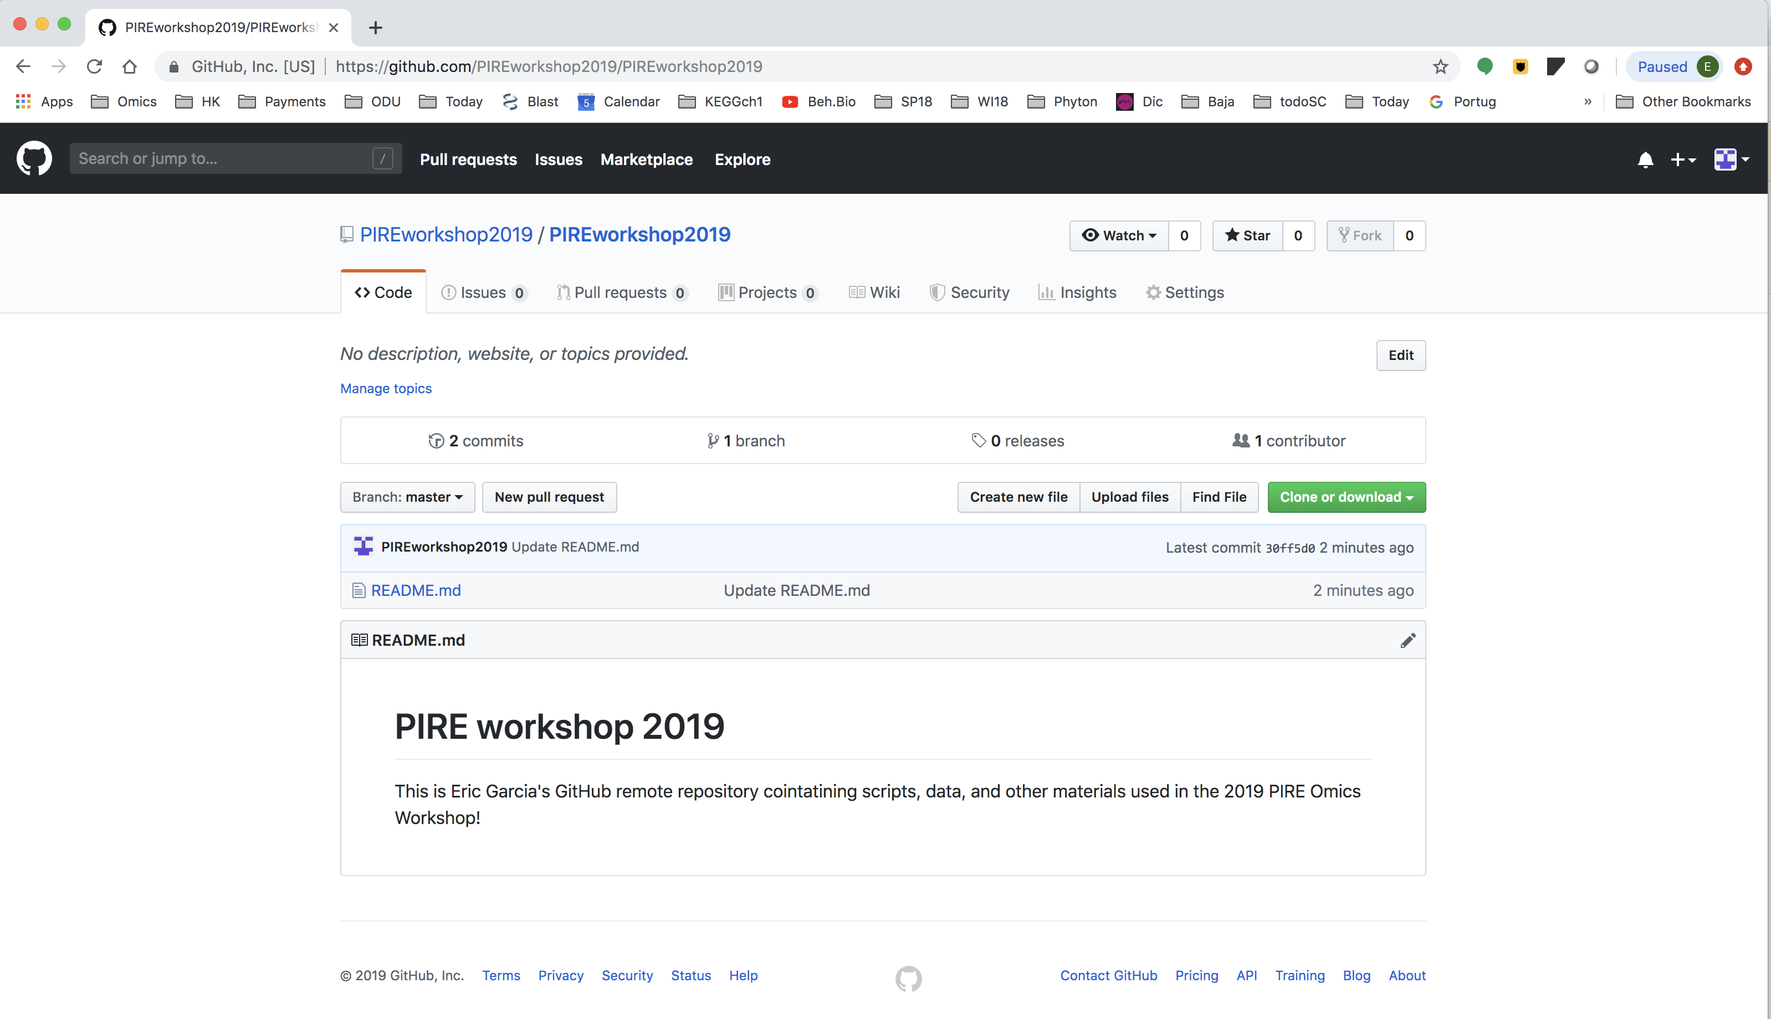

Slide 70
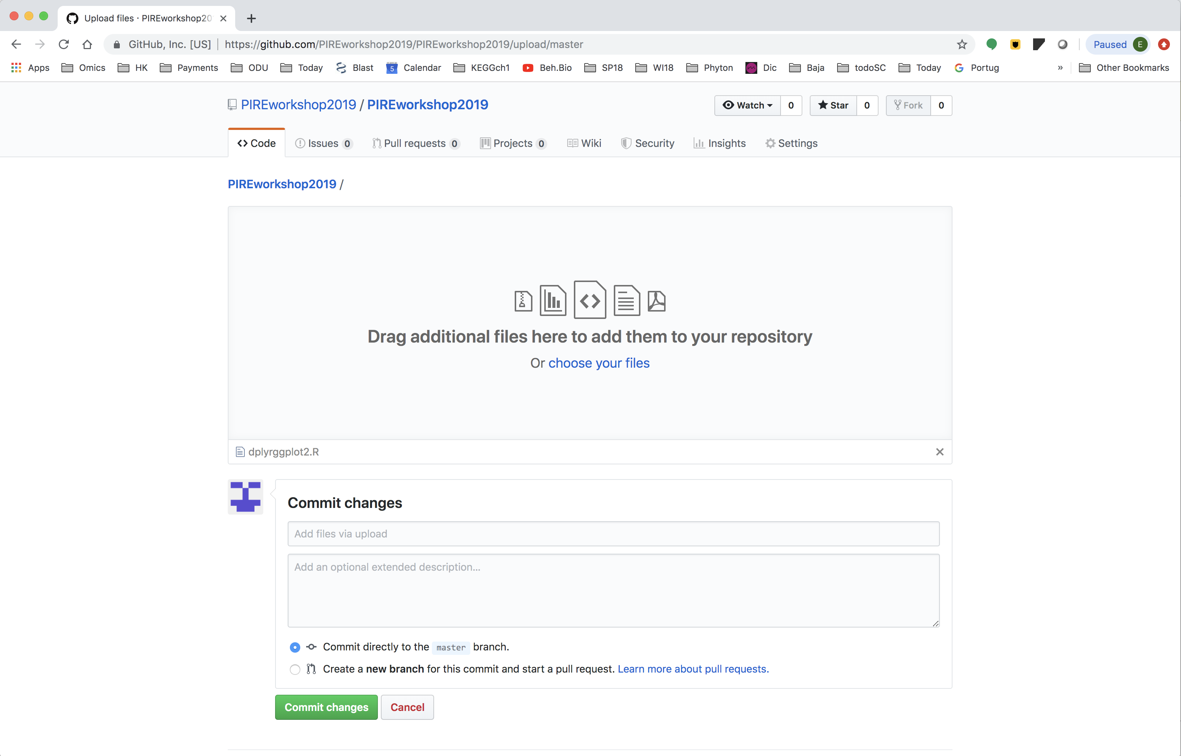
Drag a file
Then, commit

Slide 71
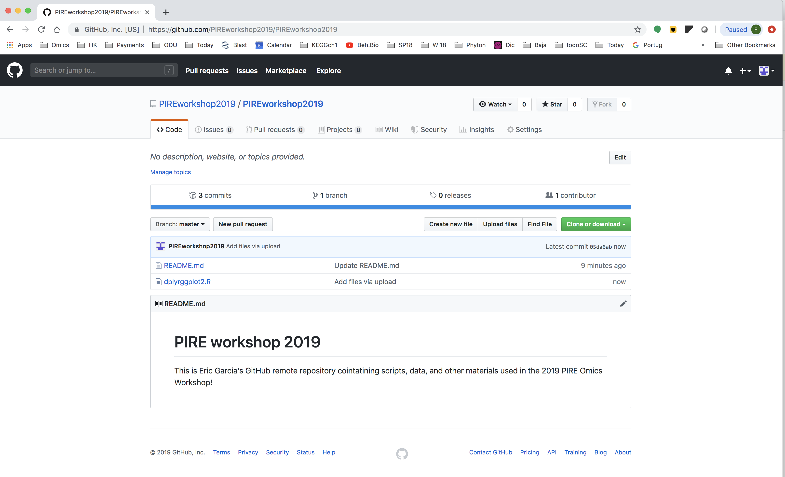

Slide 72
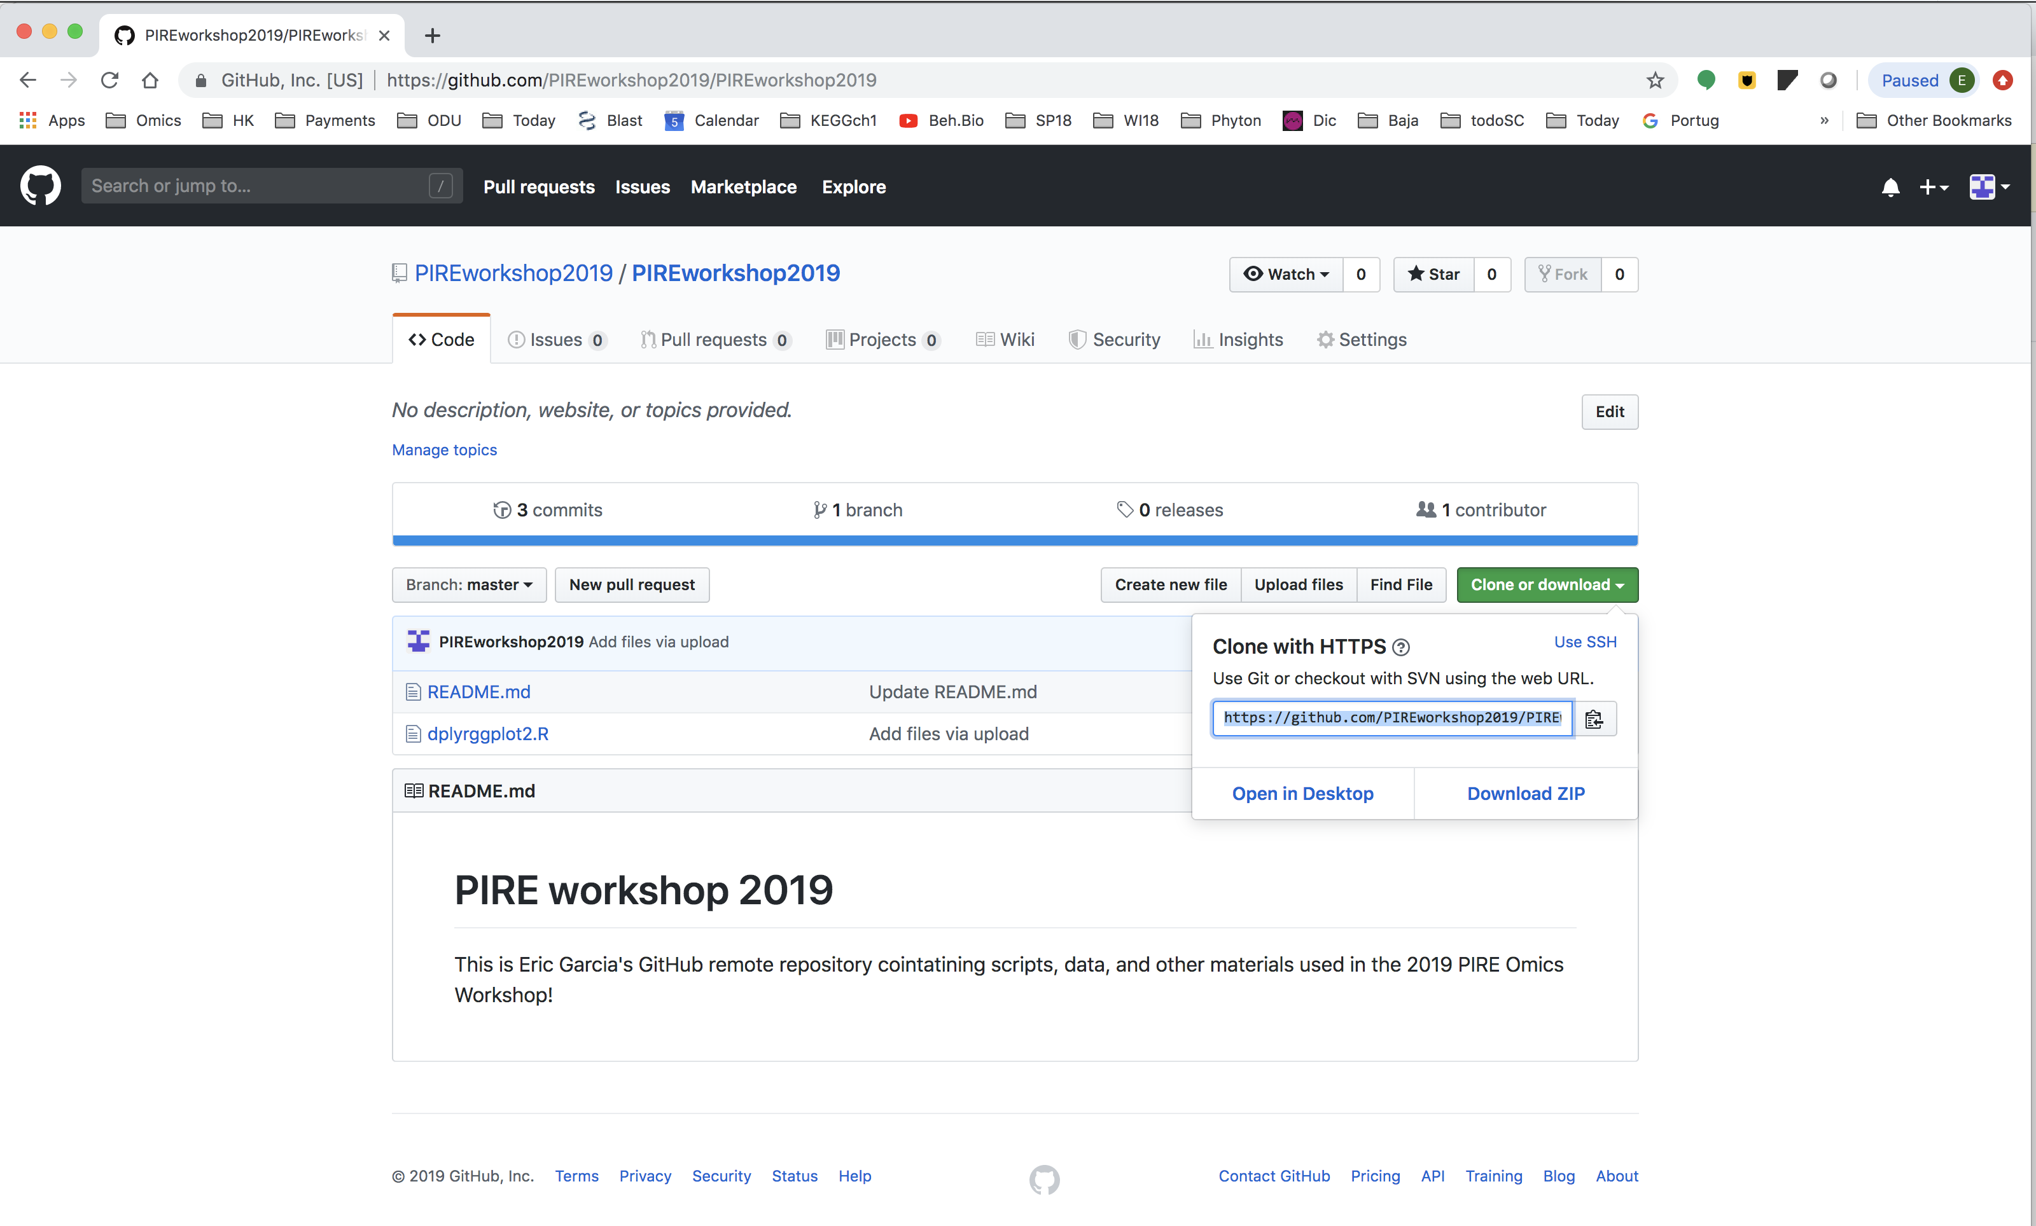

Slide 73
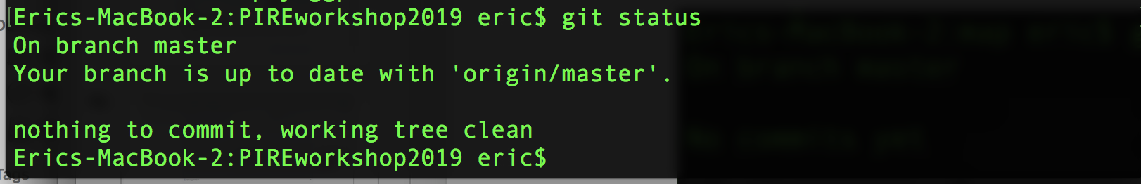
cd ~/CSB/git/sandbox/
mkdir PIREgitHub
cd PIREgitHub
git clone https://github.com/PIREworkshop2019/PIREworkshop2019.git

Slide 74
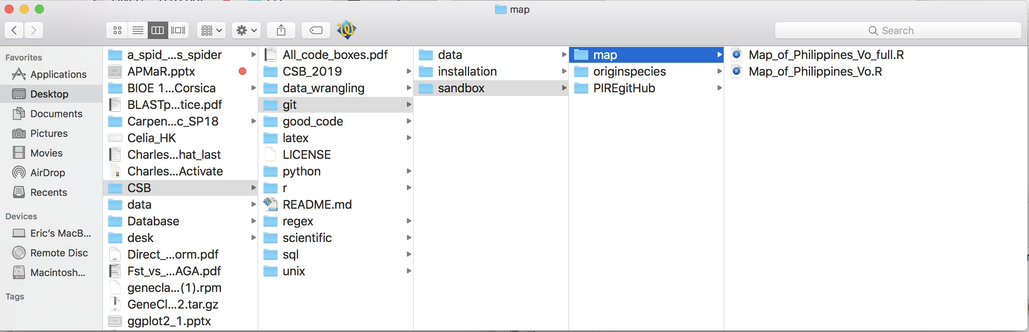
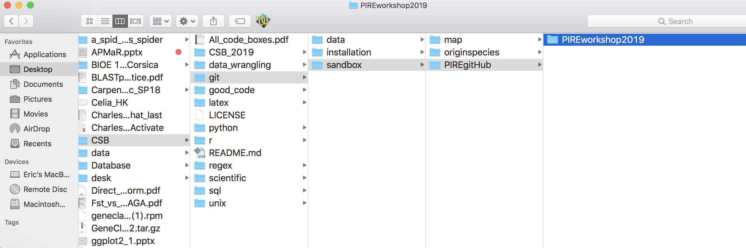
Drag a file

Slide 75
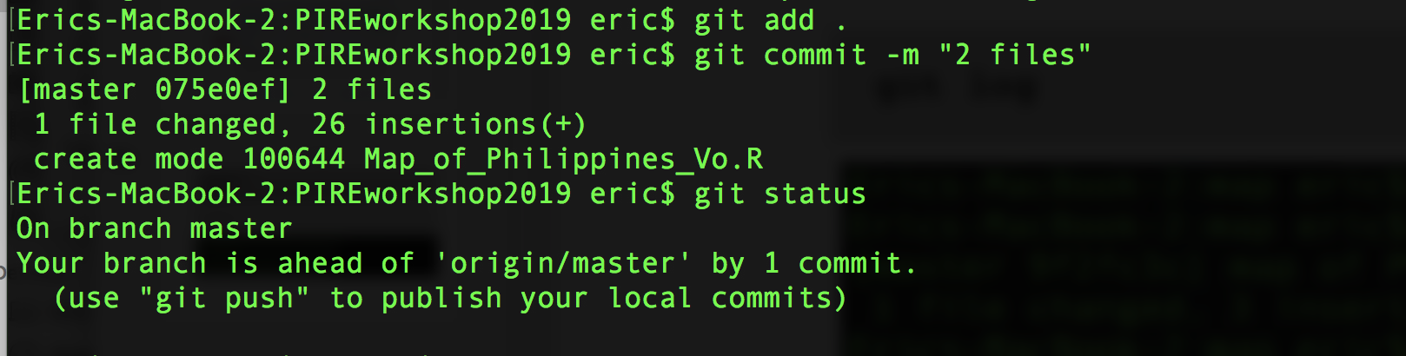
“map of the Philippines with color”
.
“2 files”

Slide 76
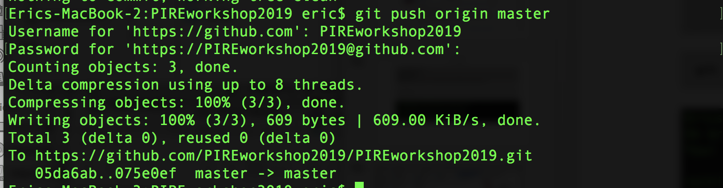
git push origin master
Enter your Username and Password:

Slide 77
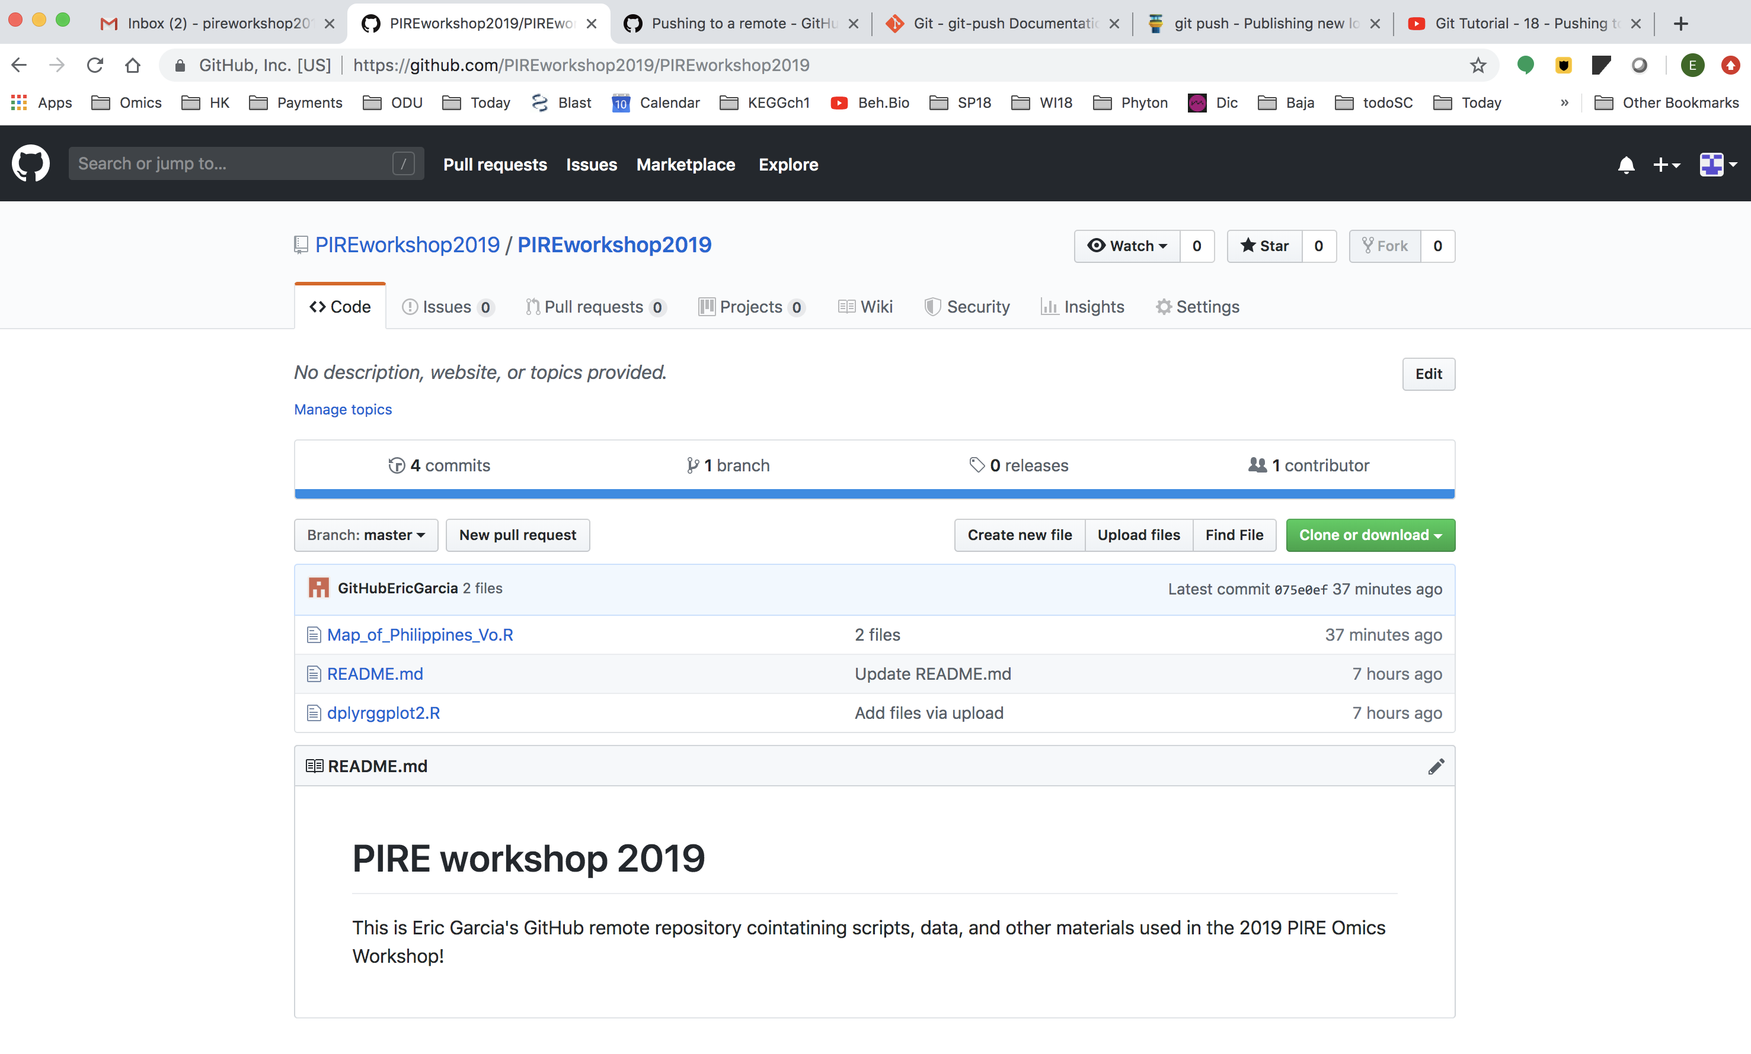

Slide 78


Thank you GitHub!

